Slide 1
FIET Introduction
FMMI Intelligent Enterprise Transformation (FIET) Project

Slide 2
Agenda
What is FIET?
Why modernize FMMI?
What will be the key changes for end users?
How will end users be involved?

Slide 3
What is FIET?

Slide 4
The FIET Project
FIET (FMMI Intelligent Enterprise Transformation) is the project in which we are migrating the existing FMMI system from SAP ECC to SAP S/4HANA. This project represents a key milestone in USDA’s journey towards digital transformation and enhanced efficiency.
FMMI
SAP ECC version
FMMI
SAP S/4HANA version
FIET Project
Current financial system
Future financial system

Slide 5
Our journey
Future
Present
FMMI
SAP S/4HANA
Past
FMMI
SAP ERP
FFIS
Mainframe
S/4HANA is like a new car with a more powerful engine, slick interior, and all the latest cool features. Even so, there will still be an adjustment period as you get the driver’s seat right where you want it, set your radio presets, and perfect parking in your garage.

Slide 6
FIET Project Objectives
Objectives
Data Quality & Information Lifecycle Management
Develop and implement a comprehensive data management strategy to optimize system performance and reduce costs​
Project Management, Organizational Change Management, & Training
Institute processes and oversee transformative changes to minimize user
impact and maximize successful outcomes for all FMMI workflows and end users
FMMI S/4HANA
Grants Solution Integration
Integrate ezFedGrants grantor functionality from SAP CRM to SAP S/4HANA; integrate existing Pega portal interface
Selective Data Transition
Transform FMMI ERP system to S/4HANA providing enhanced financial functionalities and user experience

Slide 7
Why Modernize FMMI?

Slide 8
Why Upgrade FMMI?
Simplification
Supportability
Ease of Use
Cost Savings
Innovation
Improved
Performance
S/4HANA centralizes hardware and network resources and serves as the digital core for business process simplification.
Maintenance and support for core SAP ERP and SAP ECC release will end in 2027. S/4HANA will be supported long-term.
SAP Fiori’s UI is designed to be intuitive, personalized, responsive, and simple. It allows users to ask questions and access required details.
S/4HANA brings together analytical and transactional capabilities of a variety of systems into one location. This enables better decision making and cost efficiency.
SAP S/4HANA sets the stage for innovation. S/4HANA applications leverage speed, context, and data accessibility allowing an enterprise to make decisions that are future ready.
S/4HANA improves performance by allowing users to develop and generate reports using real-time data. This improves service for customer-centric applications.

Slide 9
SAP ECC vs. SAP S/4HANA
SAP ECC | Feature | SAP S/4HANA
Not available | Intelligent Technologies | All available – embedded machine learning, advanced analytics, and digital assistants with voice recognition
HANA database | Database | SAP S/4HANA in-memory database with optimized code set; real-time Online Analytical Processing and Online Transaction Processing from one data model
Complex data model – redundant tables for analysis means blocking and maintenance issues | Data Model | Simple data model – combined analytics and transactions, reduced reconciliation, blocking, and maintenance
Traditional processes constrained by the legacy database | Business Process | Intelligent processes powered by new technology and SAP HANA
Legacy Portal | User Interface | SAP Fiori – modern, customizable, and intuitive User Interface
On premise | Deployment | Complete choice of on premise, cloud, or hybrid

Slide 10
What will be key changes for end users?

Slide 11
What are the key changes you will experience?
1
2
3
The most notable changes to FMMI can be grouped into three categories:
Interactive menu!
Click numbers
to navigate
1. Fiori
2. Simplified Data Model
3. Customer-Vendor Integration
The fresh, new user interface with a modern look and feel.
Data tables will be combined into a single Universal Journal to improve performance and data accuracy.
Business Partner records will serve as an umbrella that captures data for related Customer and Vendor records.

Slide 12
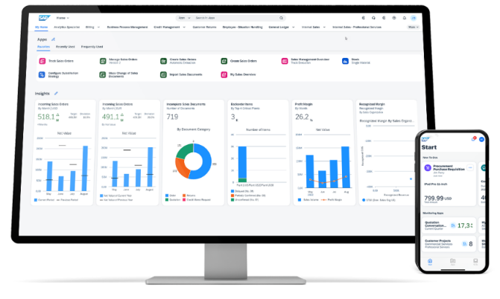
Fiori – new look and feel
Fiori will be the biggest, most noticeable change that FMMI end users will experience, and it will also bring the biggest benefits.
1
2
3
Fiori will serve as the new primary User Interface (UI) for most business transactions and will be accessed via the Portal.
Key benefits of Fiori include:
Modern, intuitive interface
Personalization options
Improved productivity
Operational metrics, enabling data-driven decision-making
Embedded analytics
Fiori will launch in February 2025.

Slide 13
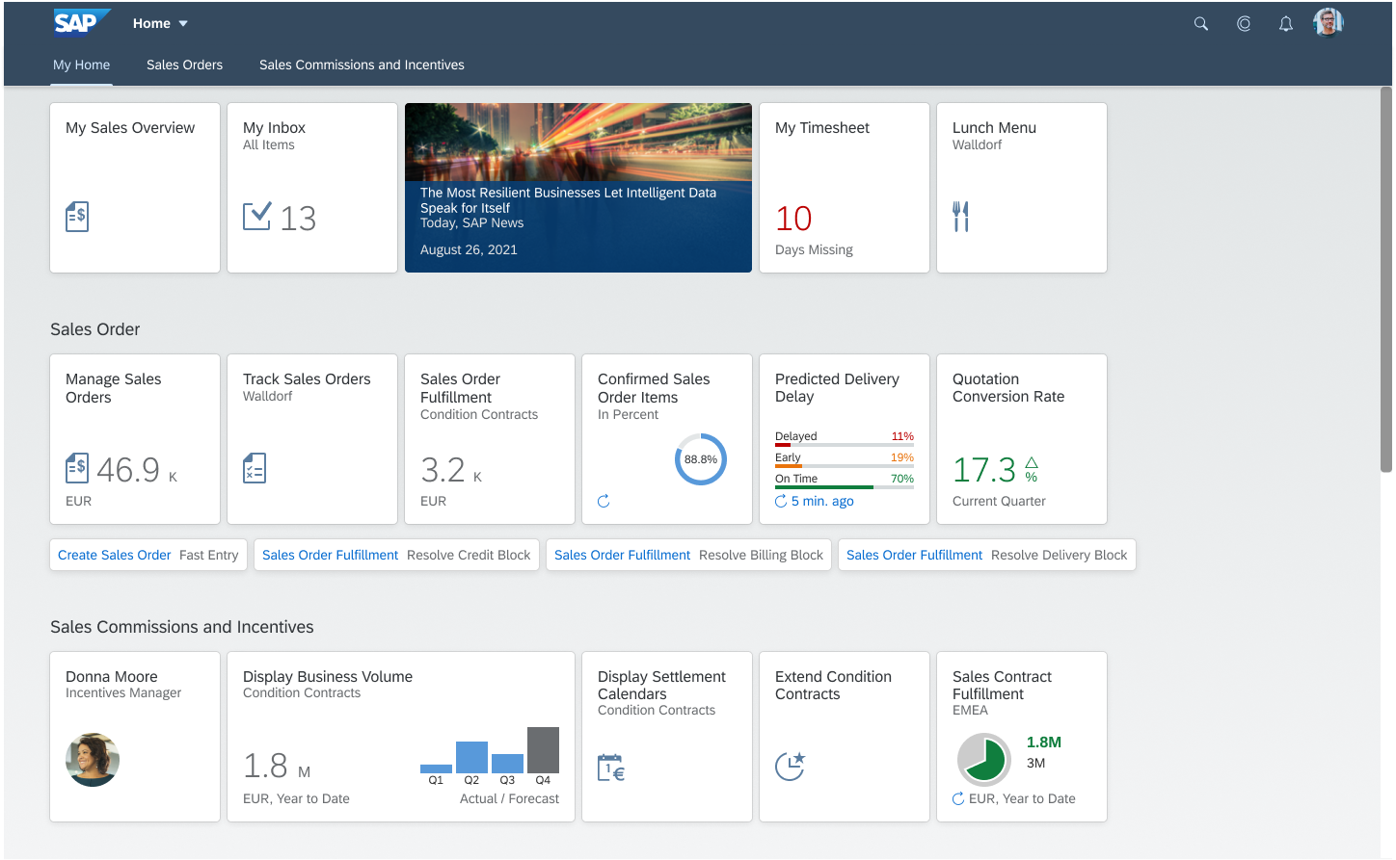
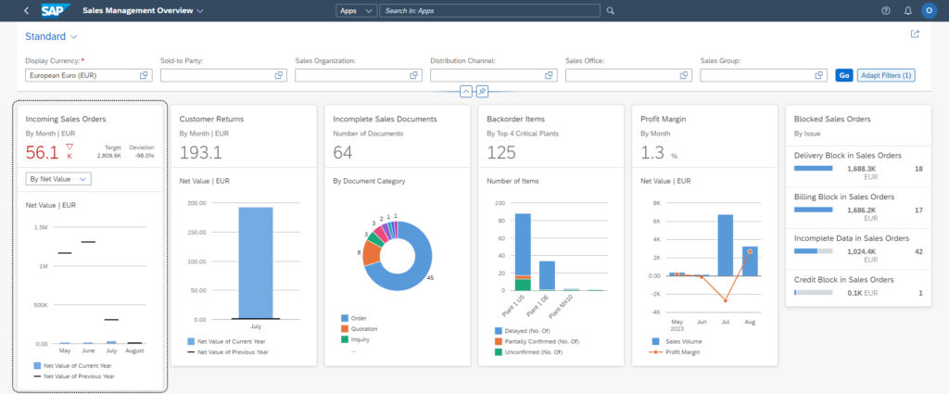
Fiori – Embedded Analytics
Key operational metrics appear directly on Fiori tiles, and users can click into operational reports to drill down and make decisions using real-time data.
1
2
3
To learn more about Fiori, watch this video.

Slide 14
Simplified Data Model
The upgrade to S/4HANA will combine data tables into a single Universal Journal to improve performance and data accuracy.
1
2
3
This will also combine ledgers, thus simplifying the data model and improving system performance and data accuracy.
Benefits of this change include:
Eliminating redundant data
Reducing database size, improving performance
Introducing a single source of information in the Universal Journal
SAP ECC
SAP S/4HANA
Universal Journal
General Ledger
General Ledger
Controlling
Controlling

Slide 15
CUSTOMER-VENDOR INTEGRETION
With the launch of FIET, we will introduce Business Partner records to FMMI. Business Partner records will serve as an umbrella that captures data for related Customer and Vendor records.
1
2
3
This change means that end users will view Business Partner records for information on customers and vendors and may experience minor changes that look and feel different from what they are familiar with today.
Business Partner Records
Customer Records
Vendor Records

Slide 16
CVI – Benefits
Key benefits of consolidating customer and vendor data under the business partner umbrella include:
1
2
3
Simplifying data management, reducing potential data redundancies and inconsistencies
Providing a more coherent view of business relationships, as a single entity can play both customer and vendor roles
Streamlining processes for creating and maintaining business partner data, leading to more efficient data maintenance and reduced manual data entry
Improved reporting, enabling USDA to gain a more comprehensive understanding of their business partner relationships

Slide 17
How will end users be involved?

Slide 18
What are customer impacts?
FMMI Code Brownout (July 2023 – May 31, 2024)
Major project code freeze. Only minor enhancements (<100 Hours) and break fixes that can be retrofitted in S/4HANA will be addressed.
FMMI Code Blackout (June 1, 2024 – Jan. 2025)​
Emergency system changes only. No other system changes will be planned or implemented.
'Big Bang’ Implementation (Feb. 2025)
All customers will go-live concurrently in the new version of FMMI. Current ECC will be depreciated at go-live and will not run in parallel with the S/4HANA system.

Slide 19
How will customers be involved?
System Integration Testing 2 (SIT 2)
Aug. – Sept. 2024
Agency Super Users will be asked to test all interfaces end-to-end to ensure they are working as planned.
Production Readiness Testing
Oct. 2024 – Jan. 2025
Agency business users will conduct end-to-end validation testing.
End User
Training
Nov. 2024 – Feb. 2025
Agency users will be trained on the new Fiori user interface and any minor application function changes.
Deployment
Cutover & Go Live
Feb. 2025
Agency participation in post go-live validation as required.
Hypercare Post Go Live Support
90 Days Post Go-Live
Our vendor partners will closely monitor the customer service, data integrity, and smooth operation of the implemented S/4HANA solution. Agency interaction may be required to troubleshoot agency-specific issues.
*Dates are tentative and will be updated as needed as the project progresses.

Slide 20
FIET Project Roadmap
INITIATE
CONFIRM
DESIGN & BUILD
INTEGRATE
DEPLOY
SUPPORT
SEP 23 | OCT 23 | NOV 23 | DEC 23 | JAN 24 | FEB 24 | MAR 24 | APR 24 | MAY 24 | JUN 24 | JUL 24 | AUG 24 | SEP 24 | OCT 24 | NOV 24 | DEC 24 | JAN 25 | FEB 25 | MAR 25 | APR 25 | MAY 25
FIET Project Kickoff
9-5-23
Process Analysis
Planning & Operationalizing
Blueprinting
System Conversion
Design and Build
End-to-End Testing
Data Migration and Verification
Training
GO LIVE
Targeted 2-17-25
Post Go-Live Support

