Slide 1
Tribal Insurance Processing System (TIPS) 101 Training

Slide 2
Welcome and Introductions
Welcome
Introductions
Restrooms
Parking Lot
Review Learner Materials
Notes:
Slide Direction:
Welcome everyone and present discussion bullets
Key Items to Note:
None

Slide 3
Agenda
Lesson / Activity | Duration
Lesson 1: FEHB Overview | 30 minutes
Lesson 2: TIPS and Enrollments | 45 minutes
Break | 10 minutes
Lesson 3: Billing and TIPS Reports | 45 minutes
Morning Review | 20 minutes
Lunch | 60 minutes
Lesson 4: Special Transactions | 30 minutes
Lesson 5: Performing Transactions in TIPS | 90 minutes
Break | 10 minutes
Lesson 6: Obtaining Additional Assistance | 30 minutes
TIPS Transactions References | 10 minutes
Final Review and Evaluation | 35 minutes
Notes:
Slide Direction:
Introduce the Agenda including the major lessons and when the session will finish for the day
Note: Spell out FEHB as F-E-H-B when you introduce it and every time after that
Key Items to Note:
None

Slide 4
Ground Rules
During class, please do:
During class, please do not:
Ask questions
Participate
Take notes and mark pages in your participant guide
Turn off or silence your cell phone
Text during class
Use email or the internet except during breaks
Have side conversations
Notes:
Slide Direction:
Introduce the Ground Rules
Key Items to Note:
None

Slide 5
Icebreaker
We’d like each Tribal Employer team to:
Introduction
Name
Name of your organization
Job description
Fun fact about yourself
Ask any questions you might have going into today
Notes:
Slide Direction:
Present discussion bullets
Key Items to Note:
None

Slide 6
Course Objectives
By the end of this course, you should be able to:
Describe the FEHB key stakeholders relative to TIPS
Identify how TIPS supports Tribal Employers
Explain the employee enrollment process
Explain the billing and payment processes
Enroll employees in TIPS using individual forms and Electronic Uploads
Run and review TIPS Reports and Billing Reports in TIPS
Describe special transactions including: Billing Unit/POI Transfers, Retroactive Adjustments, and Court Orders
Demonstrate how to navigate the TIPS website
Submit an inquiry using the ServiceNow Customer Service Portal
Notes:
Slide Direction:
Click 1: Describe the Federal Employees Health Benefits (FEHB) key stakeholders
Click 2: Identify how TIPS supports Tribal Employers
Click 3: Explain the process for enrollments in TIPS
Click 4: Explain the billing and payment process
Click 5: Perform enrollments using TIPS
Click 6: Review TIPS Reports and your Billing Report in TIPS
Click 7: Demonstrate an understanding of the inquiries handled by the National Finance Center (NFC) and external organizations
Click 8: Demonstrate how to navigate the TIPS website
Click 9: Submit an inquiry using the Remedy Requester Console
Key Items to Note:
None

Slide 7
Lesson 1: FEHB Overview
Lesson 1: FEHB Overview | 30 minutes
Lesson 2: TIPS and Enrollments | 45 minutes
Break | 10 minutes
Lesson 3: Billing and TIPS Reports | 45 minutes
Morning Review | 20 minutes
Lunch | 60 minutes
Lesson 4: Special Transactions | 30 minutes
Lesson 5: Performing Transactions in TIPS | 90 minutes
Break | 10 minutes
Lesson 6: Obtaining Additional Assistance | 30 minutes
TIPS Transactions References | 10 minutes
Final Review and Evaluation | 35 minutes
Notes:
Slide Direction:
Review with learners where you are in the agenda and what’s next
Key Items to Note:
None

Slide 8
Lesson 1 Objectives
By the end of this lesson, you should be able to:
Describe the FEHB program
Identify the legislation that extends FEHB to Indian Tribes, Tribal Organizations, and Urban Indian Organizations
Identify who is eligible for FEHB
List the key stakeholders in FEHB relative to TIPS
Explain how FEHB key stakeholders interact with each other
Describe how Tribal Employers join FEHB and the FEHB Tribal Agreement Package
Notes:
Slide Direction:
Present discussion bullets
Key Items to Note:
None

Slide 9
About NFC: Background
The U.S. Department of Agriculture’s (USDA) NFC is located in New Orleans, Louisiana
NFC’s mission is to provide reliable, cost-effective, employee-centric systems and services to Federal organizations, thus allowing its customers to focus on serving the Nation
NFC provides administrative payments, payroll/personnel processing, and accounting services to over 170 Federal organizations
Notes:
Slide Direction:
Present discussion bullets
Key Items to Note:
You are representing NFC
Introduce your role at NFC, if you have not already done so

Slide 10
FEHB Overview: FEHB and Tribal Employer Participation
What is FEHB?
Provides employer-sponsored health insurance to Federal employees
Administered by the Office of Personnel Management (OPM)
On March 23, 2010, President Barack Obama signed the Patient Protection and Affordable Care Act (PPACA)
PPACA extends FEHB to eligible Tribes, Tribal Organizations, and Urban Indian Organizations
How did Tribal Employers become eligible for FEHB?
Notes:
Slide Direction:
Click 1: What is FEHB bullets
Click 2: How did Tribal Employers become eligible for FEHB bullets
Key Items to Note:
Frame these questions as a review of what participants learned from OPM the day before. Ask audiences the answers to the questions before showing the answers
Provide additional detail around eligible Tribes. The following are eligible:
Indian Tribes carrying out programs under the Indian Self-Determination and Education Assistance Act (ISDEAA)
Indian Tribal Organizations carrying out programs under the Indian Self-Determination and Education Assistance Act (ISDEAA)
Urban Indian Organizations: Carrying out programs under Title V of the Indian Health Care Improvement Act
If asked to elaborate on FEHB, refer them to OPM training materials or an OPM telecast about FEHB. We don’t want to give any information about FEHB that might be inaccurate or that OPM should be disseminating

Slide 11
FEHB Key Stakeholders: Overview
Notes:
Slide Direction:
Present discussion bullets
Key Items to Note:
There are five key stakeholders in FEHB:
Tribal Employees
Tribal Employers (you all)
National Finance Center (NFC)
Officer of Personnel Management (OPM)
FEHB Plan Carriers (e.g. Insurance Companies’ Plans)

Slide 12
FEHB Key Stakeholders: Tribal Employees
Tribal Employees
Tribal Employees should work with their Tribal Employers to: Select plans and submit enrollment requests Submit plan change requests Submit change of personal data requests Cancel enrollment Contact Tribal Employer or FEHB Plan Carriers with specific inquiries
Notes:
Slide Direction:
Present discussion bullets
Key Items to Note:
For questions on which Tribal Employees are eligible, please direct participants to talk to OPM. Contractors and retirees are not eligible, but there are certain nuances where part-time employees and temporary employees are covered so it is not a topic NFC should speak to

Slide 13
FEHB Key Stakeholders: Tribal Employers
Tribal Employers
Elect to participate and complete initial enrollment forms Identify eligible Tribal employees Validate Tribal employee enrollment and plan change requests Enter enrollments and plan changes into TIPS Address Tribal employee inquiries Establish payment account for pre-authorized debits and fund account monthly Submit billing, standard form processing, technical, or system related inquiries Work with NFC to facilitate enrollment reconciliations
Notes:
Slide Direction:
Present discussion bullets
Key Items to Note:
Point out that the participants attending training are in fact Tribal Employer representatives. The participants are a key stakeholder in the FEHB process

Slide 14
FEHB Key Stakeholders: National Finance Center
NFC
Maintain TIPS and provide TIPS training Collect preauthorized debit payments from Tribal Employers Reconcile administrative and financial adjustments with Tribal Employers House enrollment data Reconcile enrollments with FEHB Plan Carriers Provide TIPS inquiry support to Tribal Employers
Notes:
Slide Direction:
Present discussion bullets
Key Items to Note:
Ensure participants know that trainers are representatives of NFC and NFC is the one who developed and maintains TIPS

Slide 15
FEHB Key Stakeholders: Office of Personnel Management
OPM
Administer FEHB Negotiate FEHB benefits and rates with FEHB Plan Carriers Develop FEHB policy Provide FEHB training Address FEHB policy questions Terminate Tribal Employer Billing Unit/POIs
Notes:
Slide Direction:
Breeze through this slide if participants have already learned a lot about OPM. If participants have not attended OPM training, present discussion bullets
Key Items to Note:
Reference the fact that participants should have previously received a training about FEHB from OPM

Slide 16
FEHB Key Stakeholders: FEHB Plan Carriers
FEHB Plan Carrier(s)
Provide plan information and documentation, including health insurance card Address Tribal employee inquiries about coverage and claims Provide health insurance coverage to Tribal employees Process claims Work with NFC to reconcile enrollments using the Centralized Enrollment Clearinghouse System (CLER)
Notes:
Slide Direction:
Present discussion bullets
Key Items to Note:
FEHB Plan Carriers are synonymous with Health insurance providers. OPM’s website provides a full list of FEHB Plan carriers participating in FEHB

Slide 17
Joining FEHB
In order to join the FEHB program, the following five steps need to be completed in order to access TIPS and be enrolled into FEHB:
1
2
3
4
5
Tribal Employer completes FEHB Agreement Package
OPM and NFC verifies agreement package
Tribal Security Officer (TSO) completes NFC Security Training
TSO requests TIPS
User IDs to establish TIPS Users
NFC sets up access to requester console for online support
Notes:
Slide Direction:
Present discussion bullets
Key Items to Note:
None

Slide 18
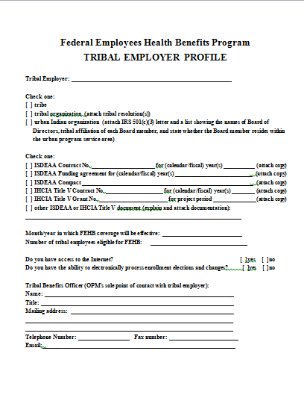
FEHB Agreement Package
Tribal Employer must complete and return the documents OPM sent, including:
Agreement to Purchase FEHB
Tribal Employer Profile
DPRS Memorandum of Understanding (MOU)
Bank Account Information Form
Authorized Contact Designation Forms (description of each listed below)
Notes:
Slide Direction:
Present discussion bullets
Key Items to Note:
Verify that all participants received and understood all of the FEHB Agreement materials
If Tribal Employers attend TIPS 101 training, but have not signed up for the program, offer a little more information about getting started in the FEHB program

Slide 19
Tribal Employer Leadership Contacts
As a part of the OPM Agreement Package, Tribal Employers must inform OPM and NFC of these contacts:
Tribal Chief Executive Officer (CEO)
1 per Tribal Employer The highest-ranking Tribal officer (executive) or administrator in charge of total management of a Tribal Employer The person who signed the Agreement with OPM Can approve Tribal Benefits Officer (TBO) and TSO
Tribal Chief Financial Officer (CFO)
1 per Tribal Employer A Tribal officer primarily responsible for managing the financial transactions of the Tribal Employer Can approve TBO and TSO roles
Notes:
Slide Direction:
Present discussion bullets
Key Items to Note:
These are specific individuals in your Tribal Employer
When joining FEHB Tribal Employers must inform OPM and NFC of their CEO and CFO. The CEO was the one who signed the Tribal Employer’s participant agreement with OPM. Both the CEO and CFO have the right to approve people for TIPS-specific roles
Ask if anyone is either the CEO or CFO for their respective Tribal Employer. If that is the case, verify that the CEO and/or CFO understand their role and responsibilities

Slide 20
Tribal Employer TIPS Contacts
As a part of the OPM Agreement Package, Tribal Employers must designate three specific contacts:
Tribal Benefits Officer (TBO)
1 per Tribal Employer Serves as the Authorized Contact for Tribal Employees, OPM, NFC, and FEHB Plan Carriers Is contacted in case of non-payment of premiums
Tribal Security Officer (TSO)
1 primary and a minimum of 1 secondary Works with NFC to establish TIPS user identifications for the Tribal Employer Resets locked out Tribal Employer’s TIPS user passwords
Authorized Maintenance Contact
2 per Tribal Employer Adds and updates contact information in TIPS for a Tribal Employer’s Authorized Contacts
*One individual can fill multiple roles
Notes:
Slide Direction:
Present discussion bullets
Key Items to Note:
Tribal Employer must designate three new contacts for FEHB. These are new positions created exclusively for TIPS
The Tribal Benefits Officer is the primary contact for most requests
Two Tribal Security Officers will be designated per tribe, a primary and secondary. The primary can start creating user accounts before the secondary has been approved, but it is best to select the roles earlier rather than later
The Authorized Maintenance Contact controls contact information in TIPS. If you need your contact information updated you must reach out to your Authorized Maintenance Contact
Ask participants if they know who fills these roles for their Tribal Employer
For small trainings it might be good to ask TSOs if they have completed their training and obtained all necessary information

Slide 21
OPM Agreement Package Verified
NFC and OPM will work together to verify completion of your Tribal Employer’s agreement package
A NFC Customer Management Branch representative will contact your TBO with the required steps to establish your Tribal Employer’s Authorized Maintenance Contact(s)
complete
Notes:
Slide Direction:
Present discussion bullets
Key Items to Note:
None

Slide 22
TIPS Security Officer Training
An NFC security representative will contact the newly designated TSO(s) to arrange security training
Security training is required for all TSO(s)
TSO training covers:
NFC’s Access Management Branch responsibilities
TIPS Security Officer responsibilities
Samples of security access requests
Opening a (inquiry) ticket in the ServiceNow Customer Service Portal
Notes:
Slide Direction:
Present discussion bullets
Key Items to Note:
None

Slide 23
TIPS User ID Establishment
After TSO(s) have received security training, they must submit User ID requests to NFC for individuals who will access TIPS
TSO(s) may assign one of the following roles:
Role | Description | TIPS Access
Update/Tribe (e.g. Human Resources Staff) | Standard Tribal Employer user | Can create/update enrollee SF 2809s and SF 2810s Can view/download TIPS Reports including TIPS Billing Reports Can submit Electronic Upload files
Update/Tribe/C (e.g. Authorized Maintenance Contact) | Same as Update/Tribe role with addition of Authorized Contact record update access | Can create/update enrollee SF 2809s, SF 2810s, and contact records (except TSO) Can view/download TIPS Reports including TIPS Billing Reports Can submit Electronic Upload files
Audit/Tribe (e.g. Finance Staff) | Same as Update/Tribe role but with read-only access to records | Can view enrollee, SF 2809s and SF 2810s Can view/download TIPS Reports
Notes:
Slide Direction:
Present discussion bullets
Key Items to Note:
None

Slide 24
Online Inquiry Submission Website (ServiceNow) Setup
At the conclusion of your Tribal Employer setup process your TBO will be given a user ID and password to use NFC’s online inquiry resolution system: ServiceNow Customer Service Portal
ServiceNow lets TBOs submit inquiries or help desk requests to the TIPS Contact Center via the internet
A TIPS Contact Center representative will contact TBOs with the steps required to establish a Tribal Employer’s account for ServiceNow use, which may include adding users in addition to the TBO
Notes:
Slide Direction:
Present discussion bullets
Key Items to Note:
More detail on how to use the system will be provided in “Obtaining Additional Assistance” lesson

Slide 25
Lesson 1 Knowledge Check
Who are the five key FEHB stakeholders?
Tribal Employees, Tribal Employers, NFC, OPM, and FEHB Plan Carriers
What is the name of the insurance system for Tribal Employers maintained by NFC?
Tribal Insurance Processing System (TIPS)
What contact is responsible for entering enrollment and plan changes into TIPS?
Tribal Employer
What contact works with NFC to establish TIPS user identifications for the Tribal Employer?
Tribal Security Officer (TSO)
Notes:
Slide Direction:
Four questions covering lesson 1. Call on different participants to answer these questions. Try to engage as many members of the audience as possible:
Click 1: Question 1
Click 2: Answer 1
Click 3: Question 2
Click 4: Answer 2
Click 5: Question 3
Click 6: Answer 3
Click 7: Question 4
Click 8: Answer 4
Key Items to Note:
None

Slide 26
Lesson 1 Summary
Now that you have completed this lesson, you should be able to:
Describe the FEHB program
Identify the legislation that extends FEHB to Indian Tribes, Tribal Organizations, and Urban Indian Organizations
Identify who is eligible for FEHB
List the FEHB key stakeholders relative to TIPS
Explain how FEHB key stakeholders interact with each other
Describe how Tribal Employers join FEHB and the FEHB Tribal Agreement Package
Notes:
Slide Direction:
Present discussion bullets
Ask additional questions on topics that learners struggle with
Key Items to Note:
None

Slide 27
Lesson 2: TIPS and Enrollments
Lesson 1: FEHB Overview | 30 minutes
Lesson 2: TIPS and Enrollments | 45 minutes
Break | 10 minutes
Lesson 3: Billing and TIPS Reports | 45 minutes
Morning Review | 20 minutes
Lunch | 60 minutes
Lesson 4: Special Transactions | 30 minutes
Lesson 5: Performing Transactions in TIPS | 90 minutes
Break | 10 minutes
Lesson 6: Obtaining Additional Assistance | 30 minutes
TIPS Transactions Reference Section | 10 minutes
Final Review and Evaluation | 35 minutes
Notes:
Slide Direction:
Review with learners where you are in the agenda and what’s next
Key Items to Note:
None

Slide 28
Lesson 2 Objectives
By the end of this lesson, you should be able to:
Define TIPS
Identify how TIPS supports Tribal Employers
Identify the components of a SF 2809 and SF 2810 in TIPS
Explain the process for performing employee enrollment transactions in TIPS
Explain the enrollment reconciliation process
Notes:
Slide Direction:
Present discussion bullets
Key Items to Note:
None

Slide 29
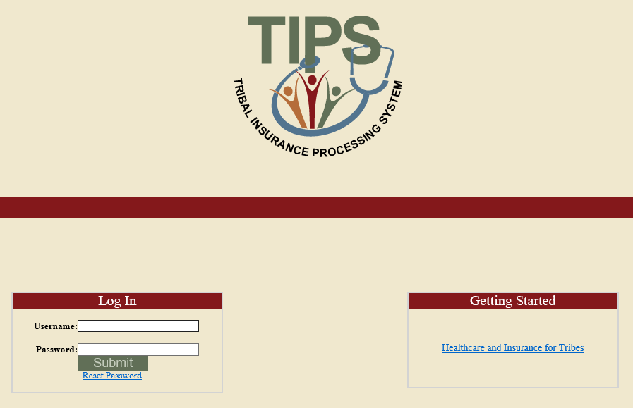
What is the Tribal Insurance Processing System (TIPS)?
A web-based system of record for FEHB enrollment information
Administered by NFC
Used by Tribal Employers to perform FEHB enrollments
Notes:
Slide Direction:
Present discussion bullets and graphic
Key Items to Note:
Ask if anyone is familiar with benefits enrollments systems. Emphasize that TIPS isn’t like a lot of systems, instead of just applying you will be actually be enrolling in the system when you use the system
TIPS also interfaces with:
FEHB Plan Carriers to transmit enrollment data
The Preauthorized Debit System (PADS) for premium collection
The Centralized Enrollment Reconciliation Clearinghouse (CLER) to reconcile enrollments with FEHB Plan Carriers
Participants will have a chance to practice using the system in Lesson 5

Slide 30
Functions of TIPS
Enrollments
TIPS Reports
Billing Reports
Special Transactions
Notes:
Slide Direction:
Present graphic discussion bullets
Key Items to Note:
Four functions:
Submit new Enrollments and Enrollment changes
View and generate Billing Report
Generate and download TIPS Reports
Complete other special transactions
Enrollments generally covers:
New enrollments
Enrollment changes
Change of name
Cancellations and terminations
Billing Report:
We will go into more detail during this lesson, but you will be able to generate two types of Billing Reports, a “PREVIEW” Billing Report can be generated at any time during the month, and will provide you with a “snapshot” of what your final bill will look like. The “FINAL” Billing Report can be generated on the last calendar day of the month, and reflects the amount of funds that will be deducted from the Billing Unit/POI’s bank account
Generate and download TIPS Reports
A large number of TIPS Reports are available to participants. TIPS Reports will include information such as:
FEHB enrollment data
Effective date of coverage
Reason for plan switch
Contact information
Other Special Transactions
You will also be able to perform a series of other transactions, such as:
Transferring enrollees from one Billing Unit/POI to another
Completing Retroactive adjustments
Adding a court order to an enrollee’s application

Slide 31
TIPS Discussion
Notes:
Slide Direction:
Pose the following two questions to the group about TIPS. The goal of the questions is to gain an understanding of learner interests and concerns about TIPS. Below are sample questions that might be useful to ask:
What about TIPS are you most interested in learning more about?
What about TIPS are you most nervous about?
Key Items to Note:
If neither of the predetermined questions are appropriate, ask participants to contribute to lesson

Slide 32
Functions of TIPS
Enrollments
TIPS Reports
Billing Reports
Special Transactions
Notes:
Slide Direction:
Present graphic
Key Items to Note:
None

Slide 33
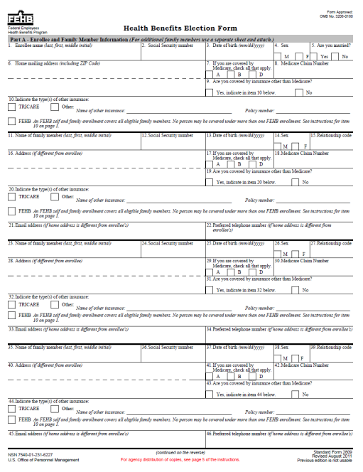
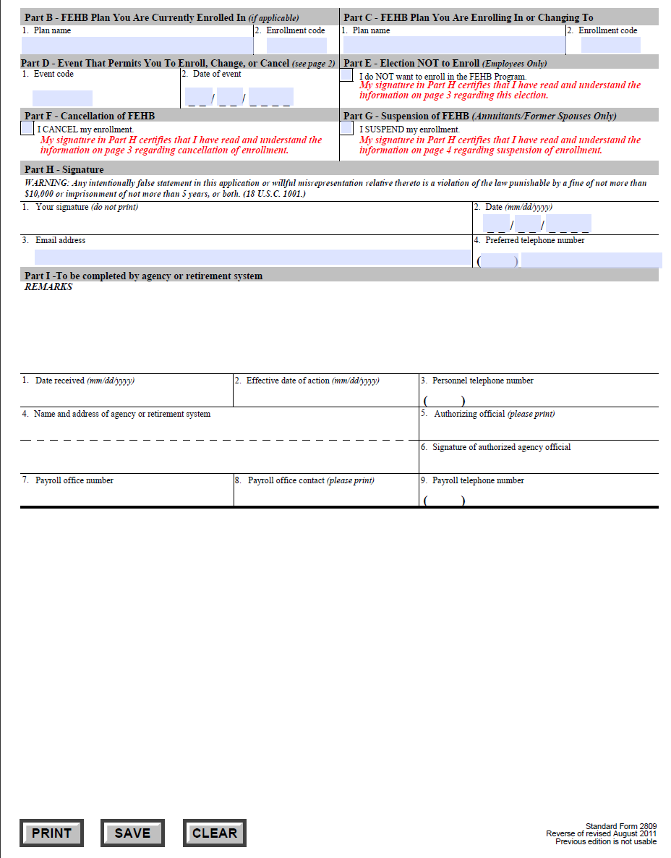
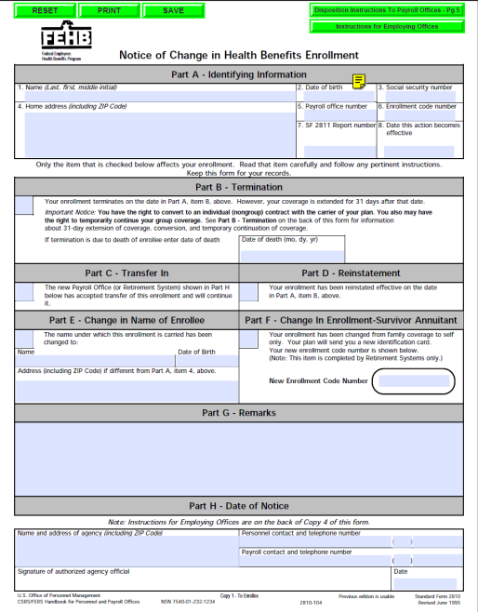
What information do I need to submit enrollments in TIPS?
Enrollments are based on the SF 2809 and SF 2810:
SF 2809: Health Benefits Election Form
SF 2810: Notice of Change in Health Benefits Enrollment
Notes:
Slide Direction:
Present discussion bullet and graphics
Key Items to Note:
In order to enroll in FEHB, all enrollees will need to complete a SF 2809. If an enrollee needs to change their name or needs to be terminated, a SF 2810 would be submitted. The images displayed are what the paper versions of these forms look like

Slide 34
SF 2809 Overview
The SF 2809 has nine parts. Only seven are included on the SF 2809 in TIPS
SF 2809 Paper Copy
SF 2809 in TIPS
Enrollee and Family Member Information
FEHB Plan You Are Currently Enrolled In
FEHB Plan You Are Enrolling In or Changing To
Event That Permits You To Enroll, Change, or Cancel
Election NOT to Enroll
Cancellation of FEHB
Suspension of FEHB
Remarks
To be completed by agency or retirement system
Enrollee Information Enrollee Information Continued; Family Members
FEHB Plan You Are Currently Enrolled In (If Applicable)
FEHB Plan You Are Enrolling In or Changing To
Event That Permits You To Enroll, Change, or Cancel
E. Cancellation
F. Remarks
G. To be completed by Tribal Employer
Notes:
Slide Direction:
Click 1: Grays out part (E and G) on the SF2809 Paper Copy
Key Items to Note:
List the nine parts briefly but don’t describe how to fill out any section of the form only high level overview
Two parts of the SF 2809 are not replicated:
Election NOT to Enroll (if an employee isn’t interested in enrolling they would still submit a form to their Tribal Employer representative but Tribal Employer representatives would not enter a form into TIPS)
Suspension of FEHB is not a relevant field for this program and is not included on the SF 2809 in TIPS

Slide 35
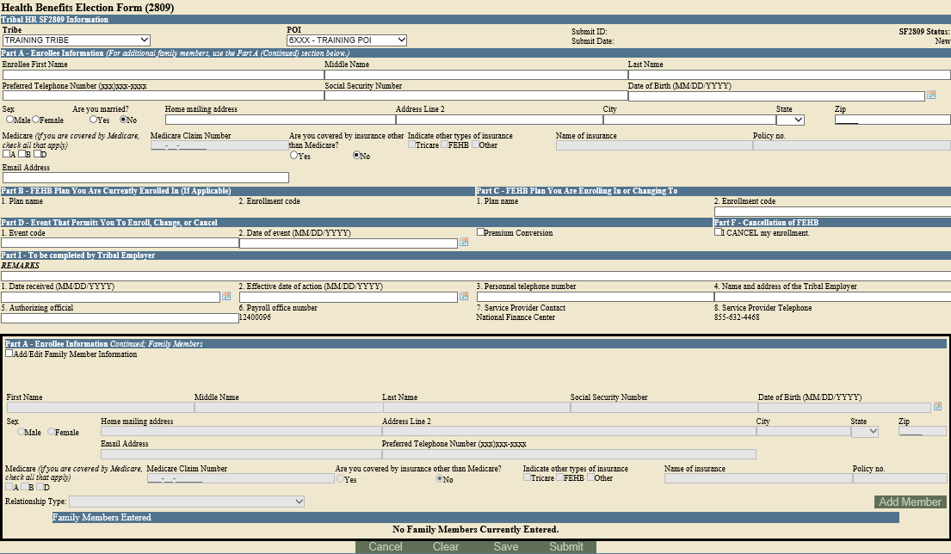
SF 2809 in TIPS
Notes:
Slide Direction:
Present graphic
Key Items to Note:
The SF 2809 in TIPS is an electronic version of the paper version issued by OPM
The TIPS SF 2809 and SF 2810 contain all the same fields as the paper versions issued by OPM with the exception of a few that are not relevant
As discussed in the previous slide, the SF 2809 in TIPS doesn’t include Part E (Election NOT to Enroll), Part G (Suspension of FEHB) or Part H (Remarks) because they are not relevant to TIPS

Slide 36
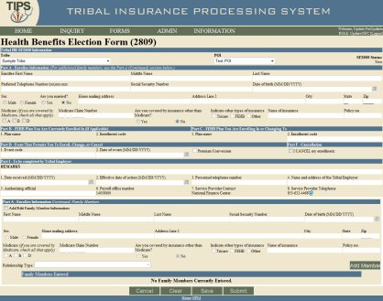
Tribal HR SF 2809 Information
When completing a SF 2809 in TIPS begin by selecting a:
Billing Unit/POI
Tribe name will be prepopulated by TIPS
Notes:
Slide Direction:
Present discussion bullets and walk through the different parts of the SF 2809 in TIPS
Key Items to Note:
At the top of the screen you will notice a box that asks you for your Tribe name and Billing Unit/POI
The Tribal Employer name will be prepopulated for Tribal Employer users
If you have access to more than one Billing Unit/POI, you will need to designate which Billing Unit/POI the enrollee is part of. If you only have access to one Billing Unit/POI you will need to select this Billing Unit/POI

Slide 37
Part A – Enrollee Information
Enter Tribal Employee’s:
Full Name
Telephone Number
Social Security Number
Date of Birth
Sex
Marital Status
Mailing Address
Medicare Information
Other Insurance Information
Email Address (optional)
Notes:
Slide Direction:
Present discussion bullets
Key Items to Note:
Tribal Employees are required to list a first and last name to save or submit a SF 2809. Middle name is optional. If a Tribal Employee only has one name, enter their name in the last name field and insert and “X” for the first name. A valid telephone number is required for all enrollments. Please note though, while this filed appears in Part A in TIPS, it is actually located in Part H of the paper copy
Social Security Number is currently required to save or submit all enrollments
Sex, Marital Status, and Mailing Address are also all required fields on the SF 2809 in TIPS
Employees are also required to check if they are covered by any insurance other than Medicare
Only if they are covered by additional insurance other than Tricare or FEHB are they required to enter the name of the insurance provider and the policy number

Slide 38
Part B and C – FEHB Plan You Are: Currently Enrolled In / Enrolling in or Changing To
Enter Tribal Employee’s:
New enrollment code if the Tribal Employee is enrolling in FEHB or selecting a new FEHB plan
Current enrollment code pre-populates with information from previous SF 2809
The FEHB Plan you are currently enrolled in is never editable
Notes:
Slide Direction:
Present discussion bullets
Key Items to Note:
None

Slide 39
What Are Enrollment Codes?
Enrollment codes are specific to:
Self Only Plans
Self & Family Plans
Self Plus One
Enrollment code is a three digit alphanumeric code:
Codes ending in 1 and 4 refer to Self Only plans
Codes ending in 2 and 5 refer to Self & Family plans
Codes ending in 3 and 6 refer to Self Plus One plans
Notes:
Slide Direction:
Present discussion bullets and table
Key Items to Note:
None

Slide 40
Sample Enrollment Codes
Self | Self & Family | Self Plus One
224 | 225 | 226
JN1 | JN2 | JN3
JN4 | JN5 | JN6
471 | 472 | 473
474 | 475 | 476
111 | 112 | 113
104 | 105 | 106
2G1 | 2G2 | 2G3
2G4 | 2G5 | 2G6
Notes:
Slide Direction:
Present discussion bullets and table
Key Items to Note:
None

Slide 41
Part D – Event That Permits You To Enroll, Change, or Cancel
Enter Tribal Employee’s:
Event Code
Refers to a specific Qualifying Life Event (QLE)
A valid event code is required on all SF 2809s
Select a Date of Event
The date an employee becomes eligible for enrollment, change of coverage, or cancellation as defined by the event code
Check Premium Conversion if Tribal Employee participates
The Premium Conversion box must be checked for Series 1 event codes
If the employee’s Billing Unit/POI does not participate in premium conversion, the employee will be unable to check the Premium Conversion box
Notes:
Slide Direction:
Present discussion bullets
Key Items to Note:
Event code refers to the QLE that applies and allows Tribal employees to make a change to their coverage
Sample events include initial employment, marriage, and open season
Presenter will cover the event codes in more detail on the next slide

Slide 42
Sample Event Codes
Premium Conversion | Non-Premium Conversion | Description
1A | 5A | Initial Opportunity to Enroll
1B | 5B | Open Season
1C | 5C | Change in family status that increases or decreases number of eligible family members
1D | 5D | Reemployment after a break in service of more than three days
A list of event codes can be found on OPM’s website.
Notes:
Slide Direction:
Present discussion bullets and table
Key Items to Note:
Events Codes are two-digit codes composed of a number followed by a letter

Slide 43
Part F – Cancellation
In order to submit a SF 2809 for a cancellation check the box in part F
Enrollees in premium conversion may only cancel following a valid QLE
Cancellations can only be effective retroactively or in the current month. The only exception is Open Season Cancellations with QLEs 1B and 5B. Cancellations must be effective 12/31 of that year
Employees NOT participating in premium conversion may cancel at any time
Event Code and Date of Event are NOT required for a cancellation if the Tribal employee is not participating in premium conversion
Notes:
Slide Direction:
Present discussion bullets
Key Items to Note:
None

Slide 44
Part I – To be Completed by Tribal Employer
Enter:
Date the employee’s SF 2809 was received by Tribal Employer
The date that any enrollment, change in coverage, or cancellation takes effect
The telephone number for the HR contact responsible for the employee or Tribal Employer benefits
Name and Address of Tribal Employer
The name of the Tribal Employer official authorizing the form
Notes:
Slide Direction:
Present discussion bullets
Key Items to Note:
Note that there is a specific type of relationship between the date of the event, the date the SF 2809 was received, and the effective date. The date of event is the date the enrollee becomes eligible for the change or enrollment in coverage. The date received is the date the HR office receives the form requesting the change or enrollment in coverage. The effective date of action is the date that the change of coverage or enrollment becomes active. The OPM QLE chart, which was provided on the previous page, governs the date windows in which changes of coverage are allowed with corresponding QLEs. The TIPS system validates date of event, date received and effective date of action fields based upon OPM's guidelines
Remarks are used by the Tribal Employer to include notes. These notes are stored in TIPS, but will not be seen by anyone outside of the Tribal Employer

Slide 45
Part I – To be Completed by Tribal Employer (cont.)
TIPS prepopulates:
Payroll Office Number (PON)
Service Provider Contact
Service Provider Telephone
Notes:
Slide Direction:
Present discussion bullets
Key Items to Note:
This information is the same on every SF2809 and is prepopulated in TIPS

Slide 46
Part A – Enrollee Information (cont.); Family Members
To add family members:
First check Add/Edit Family Member Information
Complete the enrollee information fields
Specify the relationship type of the family member
Click Add Member
All required fields must be completed to add a family member
Family members’ information will not be saved if it has not been attached via the “Add Member” button
Notes:
Slide Direction:
Present discussion bullets
Key Items to Note:
All required fields must be completed to successfully add a family member. Users will not be able to save family members if any required information is incomplete
Repeat this process for each family member you want to add

Slide 47
Sample Relationship Codes
To enter a paper SF 2809 in TIPS, one must be familiar with the following relationship types and respective codes:
Relationship Status Code | TIPS Relationship Type
01 | Spouse
09 | Adopted Child
10 | Foster Child
17 | Stepchild
19 | Child under age 26
99 | Disabled Child age 26 or older who is incapable of self-support because of a physical or mental disability that began before his/her 26th birthday
Notes:
Slide Direction:
Present discussion bullets and table
Key Items to Note:
You will notice that the “Add Family Members” section requires a relationship type for each family member added. Use this chart to determine the appropriate relationship type

Slide 48
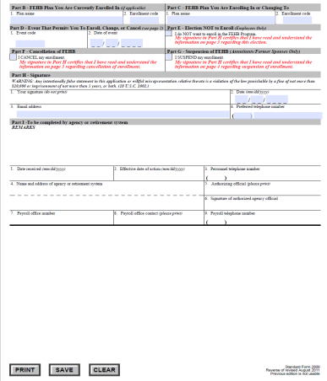
Exercise 2.1: Paper SF 2809 vs. SF 2809 in TIPS
You should have received a handout containing a:
Completed paper SF 2809
Blank printout of the SF 2809 in TIPS
Use the completed Paper SF 2809 with fields highlighted to fill out the blank printout of a SF 2809 in TIPS
Paper SF 2809
SF 2809 in TIPS
You have 5 minutes to complete this exercise
Notes:
Slide Direction:
Provide directions for exercise on transferring a Paper SF 2809 to a SF 2809 in TIPS
Key Items to Note:
None

Slide 49
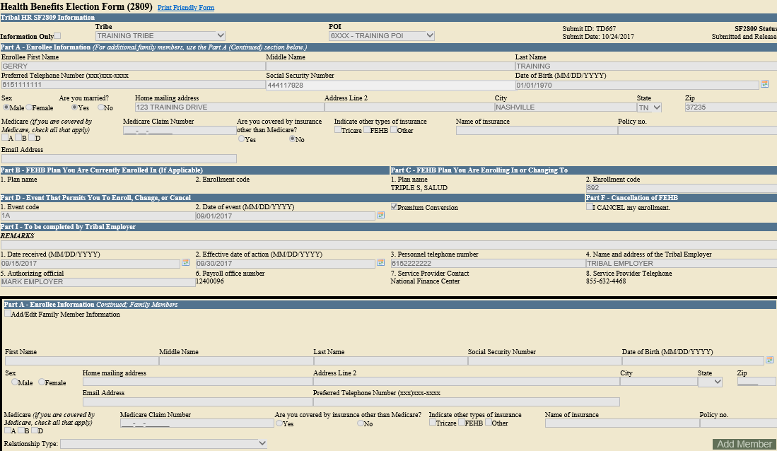
Completed SF 2809 in TIPS
Notes:
Slide Direction:
Present discussion graphic
Key Items to Note:
Ask Participants to compare their form to the completed copy on the screen

Slide 50
Exercise 2.2: Identifying the Appropriate QLE Code
In your TIPS manual, complete Exercise 2.2: Identifying the Appropriate QLE Code
Premium Conversion | Non-Premium Conversion | Description
1A | 5A | Initial Opportunity to Enroll
1B | 5B | Open Season
1C | 5C | Change in family status that increases or decreases number of eligible family members
1D | 5D | Reemployment after a break in service of more than three days
You have 5 minutes to complete this exercise
Notes:
Slide Direction:
Present discussion bullets and graphics
Provide exercise direction and review the necessary materials
Key Items to Note:
None

Slide 51
SF 2810 Overview
The SF 2810 has eight parts. Six of these parts are included on the SF 2810 in TIPS
SF 2810 Paper Copy | SF 2810 in TIPS
A. Identifying Information B. Termination C. Transfer In D. Reinstatement E. Change In Name of Enrollee F. Change in Enrollment-Survivor Annuitant G. Remarks H. Date of Notice | A. Identifying Information B. Termination C. Reinstatement D. Change In Name of Enrollee E. Remarks F. Date of Notice
Notes:
Slide Direction:
List the eight parts briefly but don’t describe how to fill out any section of the form, only provide a high level overview
Note that all sections of the SF2810 are replicated on the TIPS 2810
Key Items to Note:
Part F – Change in Enrollment Survivor Annuitant won’t be applicable to Tribal Employers

Slide 52
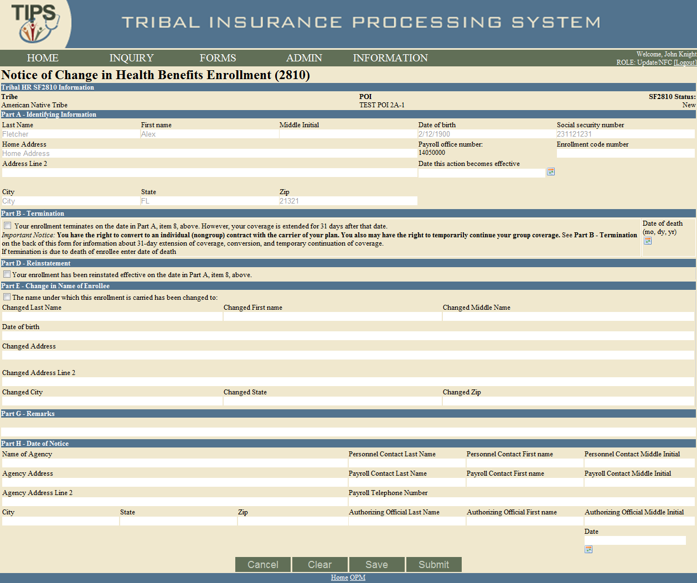
SF 2810 in TIPS
Notes:
Slide Direction:
Present discussion graphic
Key Items to Note:
TIPS SF 2810 is an electronic version of the paper copies issued by OPM
TIPS SF 2810 contains all the same fields as the paper copies issued by OPM

Slide 53
Tribal HR SF 2810 Information
When completing a SF 2810, TIPS will prepopulate the employee’s:
Tribal Employer
Billing Unit/POI
Notes:
Slide Direction:
Present discussion bullets and graphic
Key Items to Note:
None

Slide 54
Part A – Identifying Information
TIPS will auto populate:
Full Name
Date of Birth
SSN
Enter the employee’s:
Date this action becomes effective
Mailing Address
Payroll Office Number (PON)
Enrollment code number
Notes:
Slide Direction:
Present discussion bullets and graphic
Key Items to Note:
Payroll Office (PON) is fixed and pre-populated by TIPS
Enrollment code number = enrollment code (always a 3-digit number)

Slide 55
Part B – Termination
In order to submit a SF 2810 for termination check the box in part B
Only enter date of death if termination was due to the death of the employee
Tribal Employees who separate from Tribal employment are eligible for:
31-day extension of coverage
Temporary Continuation of Coverage (TCC)
Terminations can only be effective retroactively or in the current month
Notes:
Slide Direction:
Present discussion bullets and graphic
Key Items to Note:
None

Slide 56
Part D – Reinstatement
In order to reinstate an employee, check the box in part D
The effective date that is entered in Part A should be the day after the termination/cancellation date. The only exception is if the effective date is the same as the original effective date.
Possible reasons for reinstatement include:
Employee returns from military service
Erroneous error
Notes:
Slide Direction:
Present discussion bullets and graphic
Key Items to Note:
Part C is applicable if a new employee was previously employed by another Tribal Employer participating in FEHB but left that Tribal Employer to join you. The Tribal employee’s coverage can be transferred without them needing to re-apply

Slide 57
Part E – Change in Name of Enrollee
In order to change the name and/or address of the enrollee, check the Box in Part E
Enter the employee’s full new name and address
Notes:
Slide Direction:
Present discussion bullets and graphic
Key Items to Note:
None

Slide 58
Part G – Remarks
Add any relevant remarks here
Remarks may be used by the Tribal Employer to include notes
These notes are stored in TIPS, but will not be seen by anyone outside of the Tribal Employer
Notes:
Slide Direction:
Present discussion bullets and graphic
Key Items to Note:
None

Slide 59
Part H – Date of Notice
Enter Tribal Employer’s information:
Name of Tribal Employer
Tribal Employer Address
Personnel Contact Name
Personnel Contact Telephone Number
Authorizing Official Name
Today’s Date
Notes:
Slide Direction:
Present discussion bullets and graphic
Key Items to Note:
Personnel Contact Name – refers to the name of the Tribal Employer Personnel Contact
Authorizing Official Name – refers to name of the Tribal Employer HR representative authorizing this enrollment change
Payroll Contact Name and Telephone Number refer to NFC Not the Tribal Employer’s Internal Payroll Contact

Slide 60
Exercise 2.3: Paper SF 2810 vs. SF 2810 in TIPS
You should have received a handout containing a:
Completed paper SF 2810
Blank printout of the SF 2810 in TIPS
Use the completed Paper SF 2810 with fields highlighted to fill out the blank printout of a SF 2810 in TIPS
Paper SF 2810
SF 2810 in TIPS
You have 5 minutes to complete this exercise
Notes:
Slide Direction:
Provide directions for exercise on transferring the information from a Paper SF 2810 to a SF 2810 in TIPS
Key Items to Note:
None

Slide 61
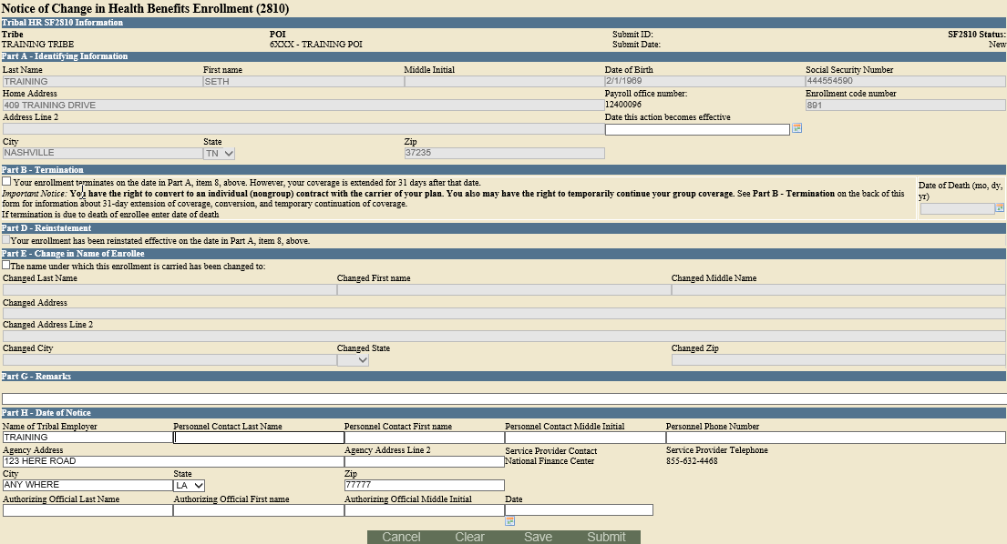
Completed SF 2810 in TIPS
Notes:
Slide Direction:
Ask Participants to compare their form to the completed copy on the screen
Key Items to Note:
None

Slide 62
Transaction Glossary
Initial
Enrollment
A Tribal Employee enrolls in FEHB for the first time
Enrollment Termination
A Tribal Employer Billing Unit/POI involuntarily ends the FEHB enrollment of a Tribal Employee
Enrollment Change
A Tribal Employee enrolled in FEHB changes his or her health plan enrollment
Billing Unit/POI Cancellation
A Tribal Employer Billing Unit/POI opts to dis-enroll from FEHB and ends coverage for its employees
Change of Name
A Tribal Employee enrolled in FEHB changes his or her legal name
Billing Unit/POI Termination
A Tribal Employer Billing Unit/POI has the FEHB enrollment involuntarily ended for its employees
Enrollment Cancellation
Change of
Address
A Tribal Employee enrolled in FEHB changes his or her primary address
A Tribal Employee enrolled in FEHB opts to dis-enroll and ends his or her coverage
Notes:
Slide Direction:
Review the definition of each of term. Please note that if the participants has questions about the process for each or intricacies of the transactions, OPM must address those questions
Key Items to Note:
A change of address doesn’t require a 2809 or 2810, only for the Tribal Employee to notify the FEHB Plan Carrier, unless the participants changes address and changes plan

Slide 63
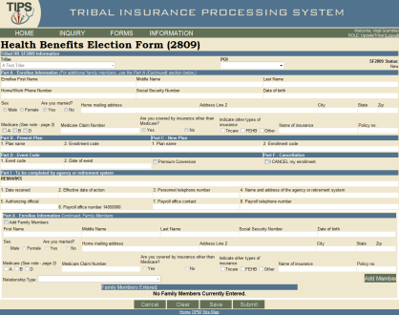
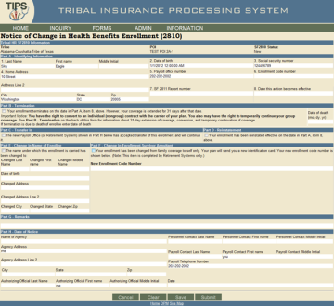
The Role of TIPS in FEHB Transactions
SF 2809 | SF 2810 | OPM
Tribal Employer completes a SF 2809 in TIPS TIPS Processes SF 2809s and sends to FEHB Plan Carriers Transactions: Initial Enrollment Enrollment Change Cancellation Corrective Actions | Tribal Employer completes a SF 2810 in TIPS TIPS Processes SF 2810s and sends to FEHB Plan Carriers Transactions: Change of Name Change of Address Termination Reinstatement | OPM cancels / terminates coverage for a Tribal Employer Billing Unit/POI TIPS prepares SF 2809s for and sends to FEHB Plan Carriers TIPS stores SF 2810s Transactions: Tribal Employer Billing Unit/POI Cancellation Termination
Notes:
Slide Direction:
Present discussion bullets and graphics
Key Items to Note:
Tribal Employers primary enrollment transactions involve entering SF 2809s and SF 2810s
OPM only has a role in the system outside of SF 2809 and SF 2810s if a Tribal Employer cancels or is terminated
For OPM initiated transactions, OPM goes into TIPS and clicks a cancel Billing Unit/POI or terminate Billing Unit/POI button
When OPM cancels a Billing Unit/POI, TIPS automatically prepares SF2809s and sends the files to FEHB Plan Carriers
When OPM terminates a Billing Unit/POI, TIPS prepares SF 2810s, but the SF 2810s are not sent to FEHB Plan Carriers since terminated Tribes are not eligible for TCC

Slide 64
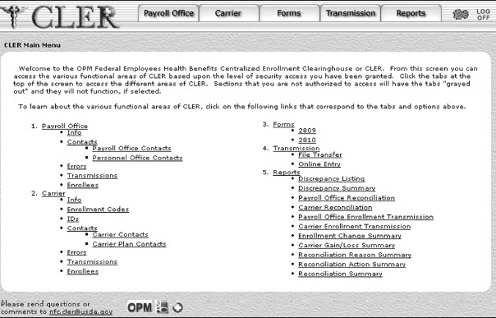
Enrollment Reconciliation Process
NFC and FEHB Plan Carriers reconcile enrollment records quarterly using CLER
CLER is a NFC web-based system that receives and processes enrollment data from government agencies and FEHB Plan Carriers
FEHB Plan Carriers and NFC submit their enrollments to CLER
After CLER processing, NFC communicates with Tribal Employers and Carriers to resolve discrepancies, as needed (it’s possible you may never receive any communication from the NFC CLER team)
Notes:
Slide Direction:
Present discussion bullets and graphic
Key Items to Note:
The CLER process occurs quarterly
CLER most likely will not affect Tribal Employers unless a discrepancy occurs (which is uncommon)
If there are no discrepancies in your Billing Unit/POI, Tribal Employers will not be contacted
Guidance from NFC will be provided as needed

Slide 65
Enrollment Reconciliation Process (cont.)
CLER compares enrollment information and identifies discrepancies on a quarterly basis
NFC contacts Carriers to resolve discrepancies
NFC works with Tribal Benefits Officer to resolve discrepancies
NFC and Carriers submit enrollment information to CLER
TIPS must be updated to reflect changes
Notes:
Slide Direction:
Present process flow
Key Items to Note:
None

Slide 66
Lesson 2 Knowledge Check
What are the four main TIPS functions?
Enrollments, Billing, TIPS Reports, and Special Transactions
Tribal Employers complete what two forms in TIPS to perform FEHB transactions?
A SF 2809 or SF 2810 would be completed in TIPS
True or False: The premium Conversion Box must be checked for an enrollment with a series 1 event code?
True
OPM uses TIPS to perform what two FEHB transactions?
Tribal Employer Billing Unit/POI Cancellation
Tribal Employer Billing Unit/POI Termination
Notes:
Slide Direction:
Present discussion bullets
Ask additional questions on topics that learners struggle with
Key Items to Note:
None

Slide 67
Lesson 2 Summary
Now that you have completed this lesson, you should be able to:
Define TIPS
Identify how TIPS supports Tribal Employers
Identify the components of a SF 2809 and SF 2810 in TIPS
Explain the process for performing employee enrollment transactions in TIPS
Explain the enrollment reconciliation process
Notes:
Slide Direction:
Present discussion bullets and graphic
Key Items to Note:
None

Slide 68
Break – 10 Minutes

Slide 69
Lesson 3: Billing and TIPS Reports
Lesson 1: FEHB Overview | 30 minutes
Lesson 2: TIPS and Enrollments | 45 minutes
Break | 10 minutes
Lesson 3: Billing and TIPS Reports | 45 minutes
Morning Review | 20 minutes
Lunch | 60 minutes
Lesson 4: Special Transactions | 30 minutes
Lesson 5: Performing Transactions in TIPS | 90 minutes
Break | 10 minutes
Lesson 6: Obtaining Additional Assistance | 30 minutes
TIPS Transactions References | 10 minutes
Final Review and Evaluation | 35 minutes
Notes:
Slide Direction:
Review with learners where you are in the agenda and what’s next
Key Items to Note:
None

Slide 70
Lesson 3 Objectives
By the end of this lesson, you should be able to:
Explain the billing and payment processes
Identify the fields on a Billing Report
Calculate a Billing Report
Explain the Insufficient Funds Resolution Process
List the available TIPS Reports
Identify the fields on a TIPS Report
Notes:
Slide Direction:
Present discussion bullets
Key Items to Note:
None

Slide 71
Functions of TIPS
Enrollments
TIPS Reports
Billing Reports
Special Transactions
Notes:
Slide Direction:
Present graphic
Key Items to Note:
None

Slide 72
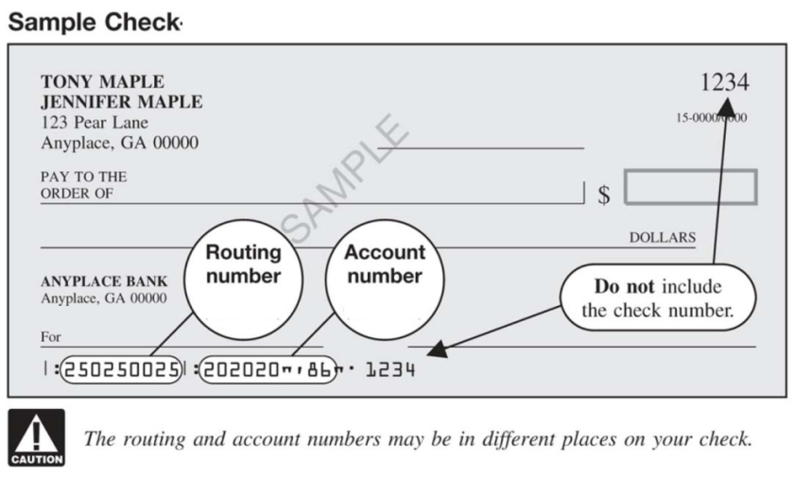
Billing Overview
Each Tribal Employer must establish one or more Billing Unit/POIs to help organize Tribal Employee enrollments for different Tribal entities/businesses
Tribal Employers must provide a bank account and routing number for each Billing Unit/POI
Notes:
Slide Direction:
Present discussion bullets and graphic
Key Items to Note:
The organization of Billing Units/POIs should be based on Tribal Employer’s individual billing and/or payroll structures
The bank account and routing number form is included in the Tribal Employer Agreement Package (referenced in Lesson 1)
NFC should already have the account information from everyone signed up in the training

Slide 73
Billing Overview (cont.)
A Preview Billing Report can be generated in TIPS at any point during the month. This is a snapshot of the final bill
Please note that the Preview Billing Report is updated with enrollee actions twice a day at 12pm CST and 3am CST. Any actions on an enrollee’s account that occurs before those times will be reflected once the Preview Billing Report is updated.
Notes:
Slide Direction:
Present discussion bullets and graphic
Key Items to Note:
A PREVIEW Billing Report will reflect the amount due for the specified date. The PREVIEW Billing Report is intended to be a snapshot of transactions up until the date it was generated for
The FINAL Billing Report can only be generated on the last calendar day of the month and reflects the amount of money that will be debited from a POI bank account. SF 2809s and SF 2810s that are in the submitted and released or processed state will appear on both PREVIEW and FINAL Billing Reports
For more information about the Billing Report, refer to the TIPS Transaction References section in the back of your Participant Guide (PG)
PADS is a background funds transfer system. As a Tribal Employer you will never actually see PADS running
Tribal Employers have access to all Billing Unit/POI’s in the Tribal Employer but each Billing Unit/POI is responsible for it’s own bill (not an issue if only one Billing Unit/POI exists)

Slide 74
Billing Overview (continued)
A Final Billing Report can be generated in TIPS on the 1st calendar day of the following month. This amount reflects the amount that will be deducted from the Billing Unit/POI’s account
Electronic Billing Reports are prepared and linked to accounts at the Billing Unit/POI-level, not the Tribal Employer-level
Notes:
Slide Direction:
Present discussion bullets and graphic
Key Items to Note:
A PREVIEW Billing Report will reflect the amount due for the specified date. The PREVIEW Billing Report is intended to be a snapshot of transactions up until the date it was generated for
The FINAL Billing Report can only be generated on the last calendar day of the month and reflects the amount of money that will be debited from a POI bank account. SF 2809s and SF 2810s that are in the submitted and released or processed state will appear on both PREVIEW and FINAL Billing Reports
For more information about the Billing Report, refer to the TIPS Transaction References section in the back of your Participant Guide (PG)
PADS is a background funds transfer system. As a Tribal Employer you will never actually see PADS running
Tribal Employers have access to all Billing Unit/POI’s in the Tribal Employer but each Billing Unit/POI is responsible for it’s own bill (not an issue if only one Billing Unit/POI exists)

Slide 75
TIPS Billing Report
TIPS users can view their preview Billing Report at any time
Each Billing Report contains:
Tribal Employer
Number
Billing Unit/POI
Enrollee Name
Enrollee SSN
Enrollment Code
Premium Amount
Administrative Fee
Adjustments
Enrollee Bill Amount
Total Premium Amount
Total Administrative Fee
Total Adjustments
Total Bill Amount
Notes:
Slide Direction:
Present discussion bullets and graphic
Key Items to Note:
None

Slide 76
Calculating a Billing Report
Billing Reports are composed of two components:
Plan premium
The formula to calculate each Billing Reports is:
TIPS adds up the premiums and administrative fees for Tribal Employees in your Tribal Employer Billing Unit/POI to calculate a Billing Report
For example, the cost for self-only Puerto Rico Triple-S Salud, Inc. FEHB Plan would be:
Administrative fee
(Plan premium) + (Administrative fee) = Amount Due
($335.57) + ($12.00) = $347.57
Notes:
Slide Direction:
Present discussion bullets
Key Items to Note:
Plan premium refers to the total monthly cost of the plan (includes both the employer and employee share; this is prorated)
The Administrative Fee is $15.15, as of Spring 2012 (this is not prorated)
The Billing Report calculation is very simple. TIPS will calculate your bill automatically, aggregating all plan premiums, administrative fees, and adjustments

Slide 77
Prorated Billing
Premiums are prorated when coverage does not start on the first of the month
The administrative fee is never prorated
The formula to calculate a prorated bill is:
The prorated cost for self-only Puerto Rico Triple-S Salud, Inc. from May 7th until the end of the month would be:
(Plan premium) X (Days covered / Days in month) + (Administrative fee) = Amount Due
($335.57) X (25/31) + ($12.00) = $282.62
Notes:
Slide Direction:
Present discussion bullets
In the example:
May has 31 days, there are 6 days before May 7th. Including May 7th, the employee would have coverage for 25 days that month (31-6) =25
Key Items to Note:
TIPS prorates ONLY the plan premium when an employee joins the program on any day other than the first of the month
Tribal Employees joining initially should have an effective date on the first day of the employee pay period. That is the date from which you would pro-rate

Slide 78
Billing Process
Accounts must be fully funded on the first business day of the month
On the third business day of the month PADS deducts the amount on the final Billing Report
TIPS will update to reflect that accounts have been paid
PADS prepares to debit accounts over the first two business days of the month
Billing Report closes on 11:59 PM Mountain Time on the last calendar day of the month
TBO is notified within 1 to 2 weeks by OPM if account does not have sufficient funds
Notes:
Slide Direction:
Present process flow
Key Items to Note:
PADS will not perform partial deductions
If the Billing Unit/POI’s account doesn’t contain sufficient funds the insufficient funds payment process will be initiated and the Tribal Employer will be contacted by OPM

Slide 79
Billing Calendar
View Billing Calendar
The Billing Report closes for the month on the last calendar day of the month at 11:59 PM Mountain Time Changes to a Tribal Employer Billing Unit/POI TIPS bank account information must be submitted at least three business days before a Tribal Employer Billing Unit/POI Billing Report closes
Notes:
Slide Direction:
Present discussion bullets and graphic
Billing Calendar is continued on the next slide
Key Items to Note:
Tribal Employers can establish internal timelines that meet or beat the TIPS billing timelines in a way that works for respective Tribal Employer payroll/accounting systems

Slide 80
Billing Calendar (cont.)
View Billing Calendar
PADS prepares to debit the Tribal Employer Billing Unit/POI bank account provided in TIPS over the first two business days of the month PADS debits the Tribal Employer Billing Unit/POI bank account on the third business day of the month
Notes:
Slide Direction:
Present discussion bullets and graphic
Emphasize the PADS run cycle and cutoff times
Key Items to Note:
None

Slide 81
FEHB Insufficient Funds Resolution Process
Notes:
Slide Direction:
Present process flow
Click 1: Alert OPM of insufficient funds
Click 2: Alert Tribal Employer of insufficient funds
Click 3: Found account and notify OPM
Click 4: Notify NFC of funded account
Click 5: Run PADS
Key Items to Note:
If your account is billed and not enough funds are available, NFC will alert OPM
OPM will contact the TBO and alert them that their account contains insufficient funds
Tribal Employer Billing Unit/POI must acknowledge that the account in question contains insufficient funds
Tribal Employer Billing Unit/POI then deposits sufficient funds in the account and notifies OPM
OPM notifies NFC that the account has been funded
NFC runs PADS on the Tribal Employer Billing Unit/POI account to collect deposited funds
If sufficient funds are not deposited, OPM will eventually terminate the Billing Unit/POI

Slide 82
Functions of TIPS
Enrollments
TIPS Reports
Billing Reports
Special Transactions
Notes:
Slide Direction:
Present graphic
Key Items to Note:
None

Slide 83
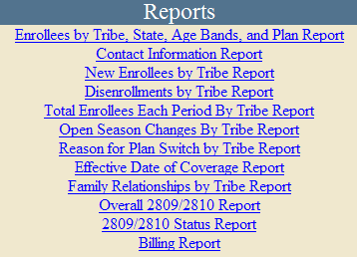
Available TIPS Reports
There are 12 principal TIPS Reports available from the left-hand side of the TIPS main page
Required Report Criteria (for non-Billing Reports): Billing Unit/POI, Start Date, and End Date
TIPS Reports can be viewed in:
The TIPS web portal
Microsoft Excel
Notes:
Slide Direction:
Present discussion bullets and graphic
Key Items to Note:
Emphasize to run reports, Tribal Employers must: select the Billing Unit/POI, Start Date, and End Date
Source data from Tribal Employees’ SF 2809 and SF 2810 is available. This report will aggregate all data fields for all SF 2809s and SF 2810s for the specified Billing Unit/POI
While Tribal Employers are not able to customize reports (beyond selecting Billing Unit/POIs and dates) in TIPS, Tribal Employers can download the source data from the SF 2809 and SF 2810s using the Overall 2809/2810 Report

Slide 84
Available TIPS Reports (cont.)
The following TIPS Reports will be available on-demand, this chart shows the Report Level of Detail:
Report Name | Billing Unit/POI | Tribe
Enrollees by state, age, and plan |  | X
New enrollees | X | X
Dis-enrollments | X | X
Total number of enrollees | X | X
Contact Information | X | X
Open Season changes | X | X
Reason for plan switch | X | X
Effective coverage date | X | X
Family Relationship |  | X
Overall 2809/2810 | X | X
Notes:
Slide Direction:
Present graphic
Key Items to Note:
Tribal Employers can view 10 prepackaged reports in the system or download to Microsoft Excel
The Overall 2809/2810 means that any field you would normally find on a SF2809/2810 you can download as raw data for all your enrolled employees

Slide 85
Excel Format
TIPS Reports exported to Excel allow for easy customization by Tribal Employers
Notes:
Slide Direction:
Present graphic
Key Items to Note:
None

Slide 86
Lesson 3 Knowledge Check
Billing Reports will be divided up by what identifier?
The Billing Unit/POI
True or False: TIPS users can view their Billing Report at any time?
True
When does a Billing Report close?
At 11:59 PM Mountain Time on the last calendar day of the month
Billing Reports are composed of what 2 components?
The plan premium and administrative fee
TIPS reports can be viewed in what two ways?
TIPS web portal or Microsoft Excel
Notes:
Slide Direction:
Present discussion bullets
Ask additional questions on topics that learners struggle with
Key Items to Note:
None

Slide 87
Lesson 3 Summary
Now that you have completed this lesson, you should be able to:
Explain the billing and payment processes
Identify the fields on a Billing Report
Calculate a Billing Report
Explain the Insufficient Funds Resolution Process
List the available TIPS Reports
Identify the fields on a TIPS Report
Notes:
Slide Direction:
Present discussion bullets
Key Items to Note:
None

Slide 88
Morning Review
Lesson 1: FEHB Overview | 30 minutes
Lesson 2: TIPS and Enrollments | 45 minutes
Break | 10 minutes
Lesson 3: Billing and TIPS Reports | 45 minutes
Morning Review | 20 minutes
Lunch | 60 minutes
Lesson 4: Special Transactions | 30 minutes
Lesson 5: Performing Transactions in TIPS | 90 minutes
Break | 10 minutes
Lesson 6: Obtaining Additional Assistance | 30 minutes
TIPS Transactions References | 10 minutes
Final Review and Evaluation | 35 minutes
Notes:
Slide Direction:
Review with learners where you are in the agenda and what’s next
Key Items to Note:
Depending on timing, consider playing Jeopardy after the lunch break

Slide 89
Review
Please break into teams
Notes:
Slide Direction:
Introduce the TIPS Jeopardy Review Game.
Break group into teams of 3 to 6 learners, dependent on class size
Ask each team to develop a team name and “buzzer sound” that can be verbal or electronic
Create a scoreboard on butcher paper or whiteboard to track responses and points
Remember to use return arrows after you access a particular question slide
Help teams cheat! Facilitators want teams to get the answers and learn how to use the Participant Guide
Key Items to Note:
None

Slide 90
Review
Review Jeopardy!
Key Stakeholders
Enrollments
Billing and Payments
TIPS Reports
Good Luck!
10
10
10
10
20
20
20
20
30
30
30
30
40
40
40
40
50
50
50
50
!
Notes:
Slide Direction:
When you click on the number itself you will be taken to the particular question
Don’t forget to use the small pink arrow in the bottom left of each question’s slide to return to main Jeopardy screen, not simply advance slide
After you select a question the text will turn black to show that it is has already been asked
If you are running out of time, click the exclamation point in the bottom right hand corner to go to the next part of the PPT
Key Items to Note:
Be flexible with answers and have fun

Slide 91
Key Stakeholders - 10 pts
This stakeholder is responsible for providing health insurance coverage to Tribal Employees.
Who are FEHB Plan Carriers?

Slide 92
Key Stakeholders - 20 pts
This stakeholder is responsible for selecting plans and submitting enrollment requests to Tribal Employers.
Who are Tribal Employees?

Slide 93
Key Stakeholders - 30 pts
This stakeholder is responsible for answering all FEHB policy questions.
Who is OPM?

Slide 94
Key Stakeholders - 40 pts
This stakeholder maintains TIPS and provide TIPS training.
Who is NFC?

Slide 95
Key Stakeholders - 50 pts
This stakeholder validates employee enrollment requests and plan change requests.
Who are Tribal Employers?

Slide 96
Enrollments - 10 pts
These two forms are used to perform enrollment transactions in TIPS.
What are the SF 2809 and SF 2810?

Slide 97
Enrollments - 20 pts
Who is responsible for entering SF 2809s and SF 2810s into TIPS.
Who are Tribal Employers?

Slide 98
Enrollments - 30 pts
If a Tribal Employer Billing Unit/POI cancels coverage, this system is responsible for preparing updated SF 2809s and submitting them.
What is TIPS?

Slide 99
Enrollments - 40 pts
Employees would select this series of event codes (1 Series, 2 Series, 3 Series, etc…) if they are participating in Premium Conversion.
What are 1 Series Codes?

Slide 100
Enrollments - 50 pts
Tribal Employers would submit what SF if they needed to terminate an Employee’s coverage?
What is SF 2810?
Notes:
Try to emphasize the distinction between termination and cancellation

Slide 101
Billing and Payments - 10 pts
This system is responsible for monthly premium collection.
What is PADS, the Pre-Authorized Debit System?

Slide 102
Billing and Payments - 20 pts
The Final Billing Report closes for the month on what day and at what time?
What is the last calendar day of the month at 11:59 PM Mountain Time?

Slide 103
Billing and Payments - 30 pts
If a Tribal Employer has an insufficient payment this organization will notify them.
Who is OPM?

Slide 104
Billing and Payments - 40 pts
What day of the month does PADS debit the Tribal Employer’s bank account?
What is the third business day of the month?

Slide 105
Billing and Payments - 50 pts
A Tribal Employer adds five employees to its insurance coverage with an effective date of May 28th. The employees will be included for the first time on the Tribal Employer Billing Reports for this month’s coverage.
What is May?

Slide 106
TIPS Reports - 10 pts
TIPS reports are available with what frequency.
What is all the time or on-demand?

Slide 107
TIPS Reports - 20 pts
TIPS Reports can be viewed in TIPS or exported to what program.
What is Microsoft Excel?

Slide 108
TIPS Reports - 30 pts
TIPS Reports are available at these two levels of detail.
What are the Billing Unit/POI-level and the Tribal Employer-level?

Slide 109
TIPS Reports - 40 pts
What three criteria must a user specify when preparing a TIPS Report.
What are the Billing Unit/POI, Start Date, and End Date?

Slide 110
TIPS Reports - 50 pts
A TIPS user would prepare this report if they wanted to see the source data for their Tribal Employees’ SF 2809s and SF 2810s.
What is the Overall 2809/2810 Report?

Slide 111
What to Expect From Lessons 4 and 5 & 6
By the end of this afternoon, you should be able to:
Understand the Special Transactions in TIPS
Access TIPS
Perform enrollment transactions using TIPS
Prepare TIPS Reports
Review your Billing Report in TIPS
Explain who to contact for additional assistance
Notes:
Slide Direction:
Present discussion bullets and graphic
Key Items to Note:
None

Slide 112
Lunch Break – 60 minutes
Notes:
Slide Direction:
Open the floor for questions and comments before breaking for lunch
Key Considerations:
None

Slide 113
Functions of TIPS
Enrollments
TIPS Reports
Billing Reports
Special Transactions
Notes:
Slide Direction:
Present graphic
Key Items to Note:
None

Slide 114
Lesson 4: Special Transactions
Lesson 1: FEHB Overview | 30 minutes
Lesson 2: TIPS and Enrollments | 45 minutes
Break | 10 minutes
Lesson 3: Billing and TIPS Reports | 45 minutes
Morning Review | 20 minutes
Lunch | 60 minutes
Lesson 4: Special Transactions | 30 minutes
Lesson 5: Performing Transactions in TIPS | 90 minutes
Break | 10 minutes
Lesson 6: Obtaining Additional Assistance | 30 minutes
TIPS Transactions References | 10 minutes
Final Review and Evaluation | 35 minutes
Notes:
Slide Direction:
Review with learners where you are in the agenda and what’s next. Confirm that participants were comfortable with material covered during morning session
Key Items to Note:
None

Slide 115
Lesson 4 Objectives
By the end of this lesson, you should be able to:
Add/remove a court ordered indicator to an employee’s enrollment records
Process an information only 2809
Explain the Enrollee Billing Unit/POI Transfer process
List the TIPS transactions that may be processed retroactively
Utilize the Delete Function effectively
Explain the History/Archive Function
Notes:
Slide Direction:
Present discussion bullets
Key Items to Note:
None

Slide 116
Manage Court Orders
The Manage Court Orders process can be used by Tribal Employers to:
Add a court ordered indicator to an active enrollee record
Remove a court ordered indicator from an active enrollee record
View all active enrollee records that contain court ordered indicators
Notes:
Slide Direction:
Example: A Tribal employee, Harrison, recently divorced his wife. Following the legal proceedings, Harrison’s Tribal Employer received a Court Ordered Mandate stating that Harrison is not legally allowed to change his health insurance (cancelling coverage or switching to a “self-only” plan). Given the situation, Harrison’s Tribal Employer must log-in to TIPS and add a court ordered mandate to his records to prevent his insurance plan from being modified
Key Items to Note:
None

Slide 117
Manage Court Orders (cont.)
Following the addition of a court ordered indicator, TIPS will prevent the active enrollee’s records from:
Voluntarily being cancelled via a new SF 2809
Being switched from a Self & Family Plan to a Self Only Plan
Being switched from a Self Plus One Plan to a Self Only Plan
Following the removal of a court ordered indicator, TIPS will allow the enrollee’s records to:
Voluntarily be cancelled via a new SF 2809
Be switched from a Self & Family Plan to a Self Only Plan
Being switched from a Self Plus One Plan to a Self Only Plan
Notes:
Slide Direction:
Present discussion bullets
Key Items to Note:
None

Slide 118
Information Only SF 2809
Information only SF 2809s are used to
Advise carriers of additions or deletions of eligible family members under a Self and Family policy.
Correct data already submitted
Name spelling or changes
Addresses
Birthdates
Social Security Numbers
Any other changes that do not involve changing enrollment codes or effective dates

Slide 119
Enrollee Billing Unit/POI Transfer
The Enrollee Billing Unit / POI Transfer process can be used by Tribal Employers to transfer an employee enrolled in FEHB to a new Billing Unit / POI
Enrollees in FEHB will be able to transfer to a new Billing Unit/POI from:
A Billing Unit / POI managed by your Tribal Employer
A Billing Unit / POI managed by another Tribal Employer participating in FEHB
Notes:
Slide Direction:
Present discussion bullets
Example: A Tribal employee, Robert, worked at a Tribal Employer’s health clinic, which had its own separate Billing Unit/POI (i.e. 6054). However, Robert decided to switch jobs and work for another business under the same Tribal Employer. Robert now works for the Tribal Employer’s casino, which has a different Billing Unit/POI than the health clinic. Given the situation, the gaining Billing Unit/POI (the casino) needs to initiate the transfer to their Billing Unit/POI. As a result of the transfer, the casino will be responsible for Robert’s health care needs
Key Items to Note:
None

Slide 120
Enrollee Billing Unit/POI Transfer (cont.)
The gaining Tribal Employer will need to determine the following information for each enrollee in order to transfer him/her to its Billing Unit/POI:
First Name
Last Name
Social Security Number
The gaining Tribal Employer will need to determine the Effective Date of Coverage for each transferred enrollee
Notes:
Slide Direction:
Present discussion bullets
Key Items to Note:
As discussed in an earlier lesson, the effective date of coverage is the date that the change of coverage or enrollment becomes active

Slide 121
Enrollee Billing Unit/POI Transfer (contd.)
As conceptualized, the following consideration must be acknowledged by the gaining Tribal Employer before transferring an enrollee to its Billing Unit/POI:
If the Effective Date of Transfer does not fall on the first of the month, the gaining Tribal Employer will be responsible for paying a prorated premium
Tribal Employers in the current POI must use the CREATE SF 2809 for the enrollee on the INQUIRY screen under the current POI to begin transfer. On the SF 2809 they must enter a Cancel date effective the last day of the pay period that the employee is in that POI
Notes:
Slide Direction:
Present discussion bullets
Key Items to Note:
None

Slide 122
Enrollee Billing Unit/POI Transfer (continued)
The gaining Tribal Employer will enter a new SF 2809 for enrollment into the new POI with an effective date one day greater than the cancellation effective date in the former POI
The enrollee can only be entered in a new POI once the cancel/termination for the former POI has been billed

Slide 123
Retroactive Adjustments
TIPS allows Tribal Employers to create SF 2809s/SF 2810s with effective dates in the past
Retroactive adjustments will be allowed for the following transactions:
Initial enrollments (SF 2809)
Enrollment code changes (SF 2809)
Cancellations (SF 2809)
Reinstatements (SF 2810)
Terminations (SF 2810)
Notes:
Slide Direction:
Example: A Tribal employee, Michael, gave notice to his Tribal Employer that he wanted to discontinue his FEHB effective January 1, 2012. On March 15, 2013, Michael’s Tribal Employer realized that Michael’s coverage was still active. To address this issue, Michael’s Tribal Employer would complete a retroactive adjustment in TIPS. Michael’s Tribal Employer would create a SF 2809 to cancel his enrollment with an effective date in the past
Key Items to Note:
None

Slide 124
Retroactive Adjustments (cont.)
The following considerations will need to be acknowledged by the Tribal Employer before completing a retroactive adjustment:
Retroactive adjustments resulting in either net credits or net debits will be displayed in the monthly Billing Report under the “Adjustments” column
Notes:
Slide Direction:
Present discussion bullets and table
Key Items to Note:
Retroactive adjustments resulting in a net credit to the Tribal Employer’s bank account will not be refunded. Such credits will be applied to future bills until the adjustment’s balance is reduced to $0
Retroactive adjustments resulting in a net debit to the Tribal Employer’s bank account will be applied to monthly bill in which the retroactive adjustment is entered into TIPS

Slide 125
Delete Function
The Delete Function can be used for non-processed and non-billed records.
Forms eligible for deletion:
Health Benefits Election Form (SF 2809)
Notice of Change in Health Benefits Enrollment (SF 2810)
The Delete button is located on the bottom of any form eligible for deletion.

Slide 126
History/Archive
When a tribal employee is terminated or cancelled, their information remains available through the Inquiry function. Should the employee return to work at the same POI or Tribe, the TBO will enter the SSN in Inquiry to retrieve the current information.
When the enrollee chooses the CREATE NEW ENROLLMENT function, the previous records are moved to history and the SSN is unlocked so the current information can be added.

Slide 127
Lesson 4 Knowledge Check
What information must you have in order to transfer an enrollee to a Billing Unit/POI managed by your Tribal Employer
First Name
Last Name
Social Security Number
What do Court ordered indicators prevent?
Voluntarily being cancelled via a new SF 2809
Being Switched from a Self & Family Plan to a Self Only Plan
True or False: Retroactive adjustments resulting in a net credit will result in a refund to your Tribal Employer’s bank account
False
Notes:
Slide Direction:
Present discussion bullets
Ask additional questions on topics that learners struggle with
Key Items to Note:
None

Slide 128
Lesson 4 Summary
Now that you have completed this lesson, you should be able to:
Add/remove a court ordered indicator to an employee’s enrollment records
Process an Information Only SF 2809
Explain the Enrollee Billing Unit/POI Transfer processes
List the TIPS transactions that may be processed retroactively
Utilize the Delete Function effectively
Explain the History/Archive Function
Notes:
Slide Direction:
Present discussion bullets
Key Items to Note:
None

Slide 129
Lesson 5: Performing Transactions in TIPS
Lesson 1: FEHB Overview | 30 minutes
Lesson 2: TIPS and Enrollments | 45 minutes
Break | 10 minutes
Lesson 3: Billing and TIPS Reports | 45 minutes
Morning Review | 20 minutes
Lunch | 60 minutes
Lesson 4: Special Transactions | 30 minutes
Lesson 5: Performing Transactions in TIPS | 90 minutes
Break | 10 minutes
Lesson 6: Obtaining Additional Assistance | 30 minutes
TIPS Transactions References | 10 minutes
Final Review and Evaluation | 35 minutes
Notes:
Slide Direction:
Review with learners where you are in the agenda and what’s next
Key Items to Note:
None

Slide 130
Lesson 5 Objectives
By the end of this lesson, you should be able to:
Access TIPS
Navigate TIPS
Perform enrollment transactions using individual forms and the electronic upload process
Prepare TIPS Reports
Review your Billing Report in TIPS
Notes:
Slide Direction:
Present discussion bullets
Key Items to Note:
None

Slide 131
How to Access TIPS
Internet access is required to access TIPS
Only authorized users can access TIPS
A Tribal Employer’s TSO is responsible for initiating and managing the creation of TIPS user accounts
After the TSO sets up the Tribal Employer’s account, NFC will email users their username and their TSO will provide those individuals with a temporary password
For the purposes of this training you will have access to a training account. This training account will expire after today’s session
Notes:
Slide Direction:
Present discussion bullets
Click 1: Blue box appears – “For the purpose this training…”
Key Items to Note:
TIPS is exclusively online. Internet access is necessary to access TIPS
The TSO should be notified if users are having difficulty securing an account
Please note the account participants will be working with during training expires after the session. Participants will not be able to access TIPS after the training day, until they have been issued their own unique user account

Slide 132
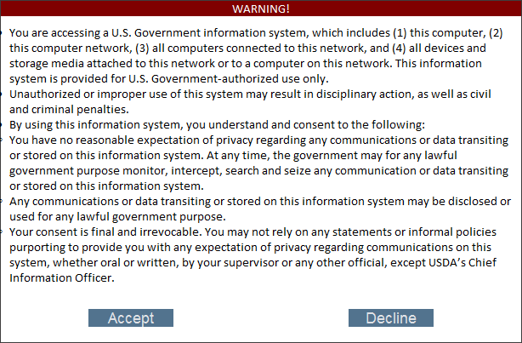
Government Disclaimer
Every time you log in to TIPS, you must accept the standard USDA system disclaimer
Notes:
Slide Direction:
Present discussion bullet and graphic
Key Items to Note:
None

Slide 133
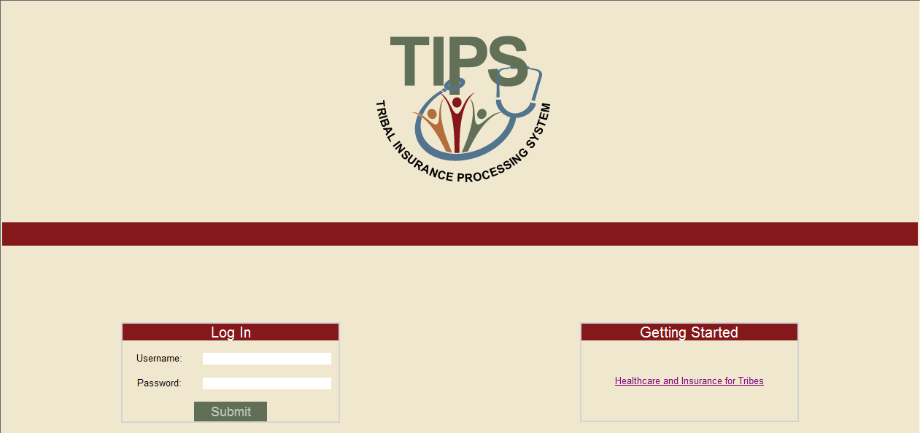
How to Log in to TIPS
Enter username and password in the Log In section
Notes:
Slide Direction:
Present discussion bullet and graphic
Key Items to Note:
None

Slide 134
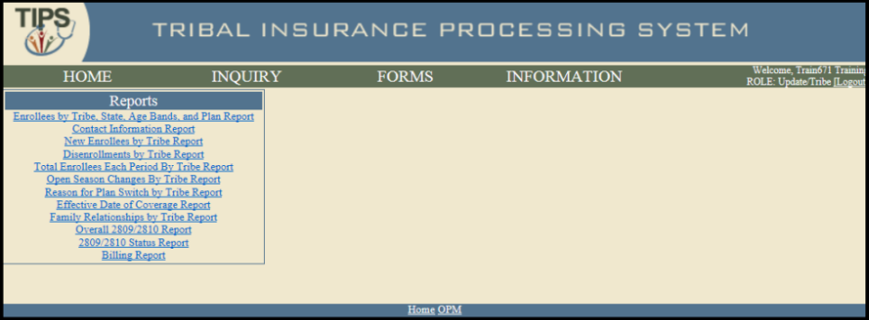
Navigating TIPS: Main Page
TIPS is broken up into five main areas:
Home
Inquiry
Forms
Information
Reports
Notes:
Slide Direction:
Present discussion bullets and graphic
Key Items to Note:
Inquiry allows users to search for an existing enrollment by employee name, SSN, or DOB; create an updated 2809; create a 2810
Forms allows users to submit an individual 2809 or 2809s through the Electronic Upload process
Admin allows users to manage contacts
Information allows users to access FAQs and contact information
Reports allows users to access all available TIPS Reports (including Billing Reports)

Slide 135
Navigating TIPS: Inquiry
The Inquiry tab allows users to:
Search for an employee enrolled in TIPS by name and/or Social Security Number / Unique Identifier
Search for active, inactive, terminated and cancelled enrollees
See submitted SF 2809s and SF 2810s
Edit SF 2809s and SF 2810s that have been saved but not submitted
Create SF 2810s
Manage Court Orders
Notes:
Slide Direction:
Present discussion bullets and graphic
Key Items to Note:
Note you can only create new SF2810s under this tab, not under forms

Slide 136
Navigating TIPS: Forms
The Forms tab allows users to:
Create a new SF 2809
Perform an Electronic Upload
Includes upload SF 2809s
Notes:
Slide Direction:
Present discussion bullets and graphic
Key Items to Note:
None

Slide 137
Navigating TIPS: Information
The Information tab allows users to:
Manage contact information
Manage account information
Notes:
Slide Direction:
Present discussion bullets and graphic
Key Items to Note:
Manage contact information provides information on how to reach OPM and NFC’s TIPS Contact Center
Manage account information provides a specific user’s:
Name
Role
Tribal Employer
Billing Unit/POI

Slide 138
Navigating TIPS: Reports
The Reports menu allows users to:
Twelve different TIPS Reports
Preview and Final Billing Report
Notes:
Slide Direction:
Present discussion bullets and graphic
Key Items to Note:
Remind participants that Reports can have flexible date ranges
If multiple Billing Unit/POIs exist, Reports can be run at the Tribal Employer and Billing Unit/POI levels (except for Billing Reports that can only be generated at the Billing Unit/POI level)
Refer participants to lesson 3 for more information about the type of TIPS Reports that can be produced

Slide 139
Navigating TIPS: User Information
User name and your level of system access are displayed in the upper right hand corner of all TIPS pages
Remember to always logout after you have finished using TIPS!
Notes:
Slide Direction:
Present discussion bullets and graphic
Key Items to Note:
None

Slide 140
Types of Transactions in TIPS
Transactions may be initiated using the SF 2809, SF 2810 or an Electronic Upload
Available transactions include:
Initial enrollment
Enrollment change
Change of name
Change of address
Enrollment cancellation
Enrollment termination
Corrective Actions
Enrollment reinstatement
Billing Unit/POI transfer process
Info only 2809
Court ordered indicator
Retroactive adjustments
Notes:
Slide Direction:
Present discussion bullets and graphic
Key Items to Note:
Note that some of the special transactions might not be in production yet

Slide 141
Electronic
Individual Forms vs. Electronic Upload
 | Individual Forms | Electronic Upload
Definition | Enter all enrollee information into TIPS, one record at a time | Upload multiple records at the same time
Pros | Simpler when performing a few transactions Easier to identify and correct errors | Saves time when performing multiple transactions Decreases the risk of manual error in TIPS
Cons | Time consuming when performing more than a few transactions Increases risk of manual error in TIPS | Errors in Electronic Uploads must be resolved individually Must adhere to a strict Electronic Upload format
Notes:
Slide Direction:
Present discussion bullets and table
Key Items to Note:
The Electronic Upload process will accept any forms without errors and only hold up those forms containing errors. A confirmation will appear on the screen when forms are successfully submitted; however, the user uploading the electronic upload file will receive a list of errors via email after submission, if applicable
Instructions on using the Electronic Upload Process are included at the end of the Participant Guide in the TIPS Reference section
TIPS Contact Center is also available to help Tribal Employers facilitate the Electronic Upload process for those interested Tribal Employers

Slide 142
Selecting a Tribal Employer and Billing Unit/POI
Before entering data in a SF 2809 or SF 2810 remember to:
Confirm that the correct Tribal Employer is selected
Select the appropriate Tribal Employer Billing Unit/POI for the Tribal Employee
Notes:
Slide Direction:
Present discussion bullets and graphic
Key Items to Note:
None

Slide 143
Entering Enrollment Data
When entering data in SF 2809s and SF 2810s users:
Can tab from field to field to quickly enter data
Must complete free response fields, select radio buttons, and mark check boxes
Must use the box for enrollee information located at the bottom of SF 2809s in order to add family members
Must have contact information for Tribal Employers representatives in order to complete these forms
Notes:
Slide Direction:
Present discussion bullets
Key Items to Note:
None

Slide 144
Finalizing a SF 2809 or SF 2810
For any new SF 2809 or SF 2810 users may select one of four options:
Option | Description
Cancel | Deletes the draft form and returns user to the main page
Clear | Deletes all data in the draft form without leaving the form
Save | Saves the draft form and allows for additional edits at a later date before submission to a FEHB Plan Carrier
Submit | Finalizes the form and sends it to the appropriate FEHB Plan Carrier
Notes:
Slide Direction:
Present discussion bullets and table
Key Items to Note:
Users will only be able to save a form if these fields are completed:
First name
Last name
Social Security Number/Unique Identifier
All required fields must completed before submitting a form

Slide 145
Holding a SF 2809 or SF 2810
After users select Submit, the form will be submitted to the appropriate FEHB Plan Carrier
If users notice an error or need to stop a form after submitting, the form can be held, if it has not been processed on the Billing Report
By holding a form, the enrollment/enrollment changes on the held form will not be reflected on the Billing Report
Users will be able to make changes to a held form
Once users have finished revising the held form, select Submit again to send it to the FEHB Plan Carrier
Notes:
Slide Direction:
Present discussion bullets and graphic
Key Items to Note:
Forms are processed each week on Wednesday evenings. Thus users can select Hold anytime up until the Wednesday evening after submitting
Held forms will not be included in on the Billing Unit/POI’s PREVIEW and FINAL Billing Report

Slide 146
Form Status
The top right corner of the form displays the status of the SF 2809 and SF 2810
SF 2809s and SF 2810s can have the following statuses:
Status | Description
New | New form, not saved or submitted
Saved | Partially filled out form, not yet submitted
Submitted and Released | Form has been completed and sent to FEHB Plan Carriers
Held for Edits | Form has been taken out of the queue for Billing Report Processing
Processed | Form has been sent to FEHB Plan Carriers and processed for billing and cannot be held
Notes:
Slide Direction:
Present discussion bullets and table
Key Items to Note:
Please be sure the user’s completed forms say submitted and released or processed, if not the form may not have made it to a FEHB Plan Carrier

Slide 147
Resolving Errors
If users attempt to submit a SF 2809 or SF 2810 with errors, TIPS will not accept the form
TIPS will list errors in red text underneath each field
Please correct any errors before submitting again
Notes:
Slide Direction:
Present discussion bullets and graphic
Key Items to Note:
None

Slide 148
Resolving Electronic Upload Errors
If TIPS identifies an error(s) after submission of an Electronic Upload, users will receive an email notifying them to log in to TIPS to retrieve and resolve any errors
All pending errors must be resolved individually in TIPS even if they were originally submitted as part of an Electronic Upload file
Double-check forms! Resolving an error before submission is always easier than afterwards!
Notes:
Slide Direction:
Present discussion bullets
Key Items to Note:
Users will be informed of the forms where errors occurred and you will have to make sure to correct each upload where an error occurred and re-submit the form after resolving any errors

Slide 149
Generating a TIPS Report
When preparing a TIPS Report, remember to select:
Billing Unit/POI
Start Date
End Date
Notes:
Slide Direction:
Present discussion bullets and graphic
Key Items to Note:
None

Slide 150
Viewing a Billing Report
Billing Reports can be prepared from the TIPS main page
Depending on the user’s role, access to may be granted to view Billing Reports for one or more Tribal Employer Billing Unit/POIs
Billing Reports are automatically updated throughout the month and reflect all SF 2809s/SF 2810s that have been submitted and processed
Notes:
Slide Direction:
Present discussion bullets and graphic
Key Items to Note:
None

Slide 151
Walkthroughs and Exercises
This section of the training will focus on practicing and performing the following transactions in TIPS:
Individual Enrollment
Updating a Saved Enrollment
Holding, Updating, and Submitting an Enrollment
Updating a SF 2809 for Open Season
Enrollment Termination
Preparing a Billing Report
Overall SF 2809/SF 2810 Report
Notes:
Slide Direction:
Present discussion bullets
Key Items to Note:
None

Slide 152
How to Access TIPS Training Environment
Follow these steps to access the TIPS Training Environment:
Open a web browser on your computer
Enter the URL provided to you on your user information handout
Refer to your user information handout for:
Temporary User ID
Temporary Password
Additional exercise information
Notes:
Slide Direction:
Help users log in to the system at this point and give them 5 minutes to play in the system before diving into the first exercise
The users will have the training environment URL on their handouts, but if possible. also write the training environment URL on a white board
Be sure to explain that the URL for the training environment is not the final TIPS URL
Click 1: Blue box appears: “You will receive a permanent TIPS username…”
Key Items to Note:
None

Slide 153
Exercise 5.1: Individual Enrollment
Create a new enrollment in TIPS
Instead of submitting the enrollment form when finished, select Save
Refer to the handout with your login information for the Social Security Number to use in this exercise
You have 10 minutes to complete this exercise
Notes:
Slide Direction:
First introduce the exercise and then open the TIPS web portal and walk through the steps to perform this transaction in TIPS before letting users begin the exercise on their own
Please direct participants to handout they received for their unique Social Security Number and Billing Unit/POI
Steps:
Open the TIPS web portal and log in with username
Select Create 2809 under the Forms tab
Select Tribe and Billing Unit/POI
Complete based on the Exercise 5.1 materials provided. Note some fields are prepopulated in the Exercise 5.1 materials, enter the information provided and create unique information for the other highlighted fields that are not already populated. These fields include:
Part A: Enrollee Information
Part C: FEHB Plan You Are Enrolling In or Changing To
Part D: Event That Permits You To Enroll, Change, or Cancel
Part I: To be completed by Tribal Employer
Once you have completed the form click SAVE
Key Items to Consider:
Please note if you Save a form without an effective enrollment date the system will automatically fill in 1/1/0001 as your effective date
Make sure to enter a valid date when editing the form or you will be unable to submit it in the system

Slide 154
Exercise 5.2: Updating a Saved Enrollment
Perform an inquiry for the SF 2809 you created in Exercise 5.1
Update the SF 2809 in TIPS adding in the spouse’s information
Submit the SF 2809
Refer to the handout with your login information for you and your spouse’s Social Security Number
You have 10 minutes to complete this exercise
Notes:
Slide Direction:
First introduce the exercise and then open the TIPS web portal and walk through the steps to perform this transaction in TIPS before letting them begin the exercise on their own
Steps for Accessing Saved Forms:
Open the TIPS web portal and log in with username
Select Enrollee under the Inquiry tab
Enter one or more of the following:
Social Security Number
First and last name
Click Search
Select View 2809
Enter all relevant fields that are highlighted in Exercise 5.2 materials. The purpose of this exercise is to add a family member (spouse)
Select Submit to submit changes for processing
Key Items to Consider:
None

Slide 155
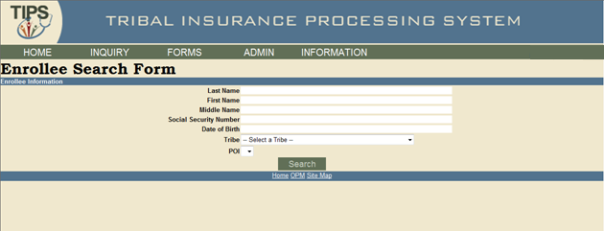
Exercise 5.3: Holding, Updating, and Submitting an Enrollment
Perform an inquiry for the SF 2809 you updated in Exercise 5.2
Hold the SF 2809 you updated in Exercise 5.2
The Enrollee’s date of birth was entered incorrectly. Update the birthday to read 03/01/1970
Submit the updated SF 2809
You have 10 minutes to complete this exercise
Notes:
Slide Direction:
First introduce the exercise and then open the TIPS web portal and walk through the steps to perform this transaction in TIPS before enabling the learners to begin the exercise on their own
Steps for Holding Submitted but not Processed Forms:
Open the TIPS web portal and log in with username
Select Enrollee under the Inquiry tab
Enter one or more of the following:
Social Security Number
First and last name
Click Search
Select View 2809
Scroll down to the bottom and select Hold
Update the Enrollee’s date of birth to 03/01/1970. Express that this exercise is to demonstrate the Hold function when an error has been made
Select Submit to submit changes for processing
Key Items to Consider:
None

Slide 156
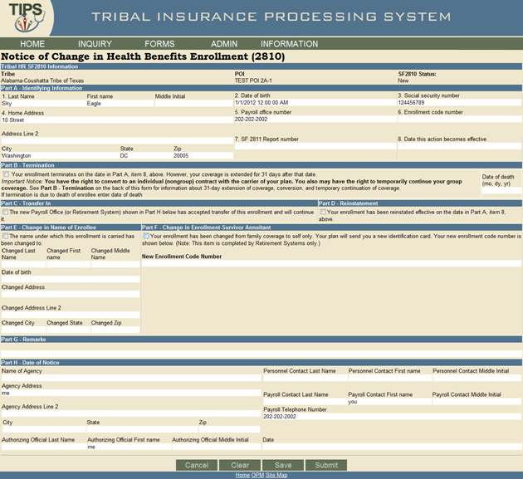
Exercise 5.4: Enrollment Termination
Terminate your assigned enrollee in TIPS using the information found in your User Login Information sheet
Refer to the handout with your login information for your enrollee’s Social Security Number
You have 10 minutes to complete this exercise
Notes:
Slide Direction:
Present discussion bullets, introduce exercise and refer participants to exercise materials
Key Items to Consider:
Open the TIPS web portal and log in with username
Select Enrollee under the Inquiry tab
Note: Enrollee is different from the enrollee used during Exercises 5.1 – 5.4. Enrollee’s name and SSN are listed on the participant’s user ID sheet provided. Enter one or more of the following:
Social Security Number
First and last name
Click Search
Select Create 2810
Update the highlighted fields found in your Exercise 5.4 materials
Select Submit to submit changes for processing

Slide 157
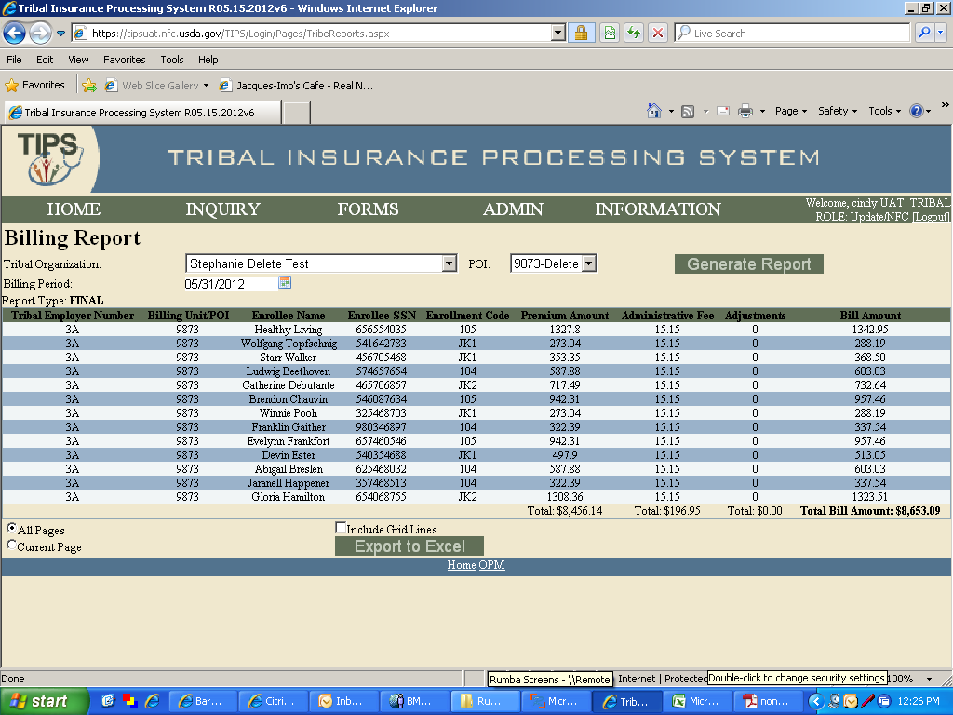
Exercise 5.5: Preparing a Billing Report
Run a Billing Report in TIPS on your Billing Unit / POI
Do not Export the report to Excel, view it in your TIPS portal
You have 10 minutes to complete this exercise
Notes:
Slide Direction:
Present discussion bullets, introduce exercise and refer participants to exercise materials
Steps – Preparing a Billing Report:
Open the TIPS web portal and log in with username
Click the Billing Report from the menu on the left-hand side of the main page
Select your Billing Report criteria:
Billing Unit/POI
Reporting Period
Click Generate Report
Steps – Downloading a Report: Once you have generated a Billing Report, you will have the option of exporting it to Excel
Customize the Billing Report with the following options:
All Pages or Current Page
Include Grid Lines
Select Export to Excel
Open report or Save to your hard drive
Key Items to Consider:
None

Slide 158
Exercise 5.6: Overall SF 2809/SF 2810 Report
Generate an Overall SF 2809/SF 2810 TIPS Report for your Tribal Employer Billing Unit/POI
Do not Export the report to Excel, view it in the TIPS portal
Open the report and review
You have 5 minutes to complete this exercise
Notes:
Slide Direction:
Steps – Preparing a Billing Report:
Open the TIPS web portal and log in with username
Click the Overall SF 2809/ SF 2810 Report from the menu on the left-hand side of the main page
Select your Overall SF 2809/ SF 2810 Report criteria:
Billing Unit/POI
Reporting Period
Click Generate Report
Steps – Downloading a Report: Once you have generated a Overall SF 2809/ SF 2810 Report, you will have the option of exporting it to Excel
Customize the Overall SF 2809/ SF 2810 Report with the following options:
All Pages or Current Page
Include Grid Lines
Select Export to Excel
Open report or Save to your hard drive
Key Items to Consider:
Very quick exercise

Slide 159
Lesson 5 Summary
Now that you have completed this lesson, you should be able to:
Access TIPS
Navigate TIPS
Perform enrollment transactions using individual forms and the electronic upload process
Prepare TIPS Reports
Review your Billing Report in TIPS
Notes:
Slide Direction:
Present discussion bullets
Key Items to Consider:
Ask if any learner has any lingering questions about the exercises completed

Slide 160
Break – 10 Minutes

Slide 161
Lesson 6: Obtaining Additional Assistance
Lesson 1: FEHB Overview | 30 minutes
Lesson 2: TIPS and Enrollments | 45 minutes
Break | 10 minutes
Lesson 3: Billing and TIPS Reports | 45 minutes
Morning Review | 20 minutes
Lunch | 60 minutes
Lesson 4: Special Transactions | 30 minutes
Lesson 5: Performing Transactions in TIPS | 90 minutes
Break | 10 minutes
Lesson 6: Obtaining Additional Assistance | 30 minutes
TIPS Transactions References | 10 minutes
Final Review and Evaluation | 35 minutes
Notes:
Slide Direction:
Review with learners where you are in the agenda and what’s next
Key Items to Note:
None

Slide 162
Lesson 6 Objectives
By the end of this lesson, you should be able to:
Describe the standard Tribal Employer inquiries
Demonstrate an understanding of the types of inquiries handled by NFC and other external organizations
Demonstrate how to navigate the TIPS website
Submit an inquiry using the ServiceNow Customer Service Portal
Notes:
Slide Direction:
Present discussion bullets
Key Items to Consider:
None

Slide 163
Standard Inquiries
Standard inquiries from Tribal Employers may include:
How do I complete a SF 2809 or SF 2810?
How do I generate a TIPS Report or Billing Report?
I received an error message in TIPS, how do I correct this error?
What prescriptions are covered under this FEHB plan?
Notes:
Slide Direction:
Present discussion bullets
Ask (engage audience): What do you all think are some possible questions you may have and need to answer by accessing the web portal, calling the TIPS Contact Center, or calling other external organizations?
So let’s take a closer look at where you should direct these inquiries:
Click 1: How do I complete a SF 2809 or SF 2810?
Click 2: How do I generate a TIPS Report or Billing Report?
Click 3: I received an error message in TIPS, how do I correct this error?
Click 4: What prescriptions are covered under this FEHB plan?
Key Items to Consider:
None

Slide 164
Inquiries Handled by NFC Contact Center and Other Organizations
NFC Contact Center
Other Organizations
Types of Inquiries:
General program inquiries
Inquiries regarding completing a SF 2809/ SF 2810
Assistance with Electronic Upload errors
Assistance with generating a TIPS Report
Billing and technical inquiries
Billing discrepancies
Assistance with navigating the TIPS website
Tribal Employers
Employee-specific inquiries
OPM
Policy Inquiries
FEHB Plan Carriers Call Centers
Coverage Inquiries
Tribal Security Officer
TIPS Username Setup and Security Inquiries
The TIPS Contact Center can be reached at: 855-NFC-4GOV
OPM Tribal Desk can be reached at: 202-606-2530
Notes:
Slide Direction:
Present discussion bullets
Click 1: Types of Inquiries (TIPS Contact Center)
Click 2: OPM
Click 3: Tribal Employers
Click 4: Carrier Call Centers
Click 5: Tribal Security Office
Some inquiries are not handled by the Contact Center and must be handled by other organizations
All coverage inquiries are handled by the Carrier call centers
All policy inquiries are handles by the Office of Personnel Management (OPM)
Employee-specific inquiries are handled by Tribal Employers (yourselves)
System Security Inquiries are handled by your TSOs
You can reach these organizations directly using the numbers provided on your Quick Reference Guide
Also, the Contact Center can always provide you with the numbers for these organizations
Key Items to Consider:
TSOs have the capability to reset passwords via SALL. There isn’t a number they need to call to be able to do it

Slide 165
Tribal Insurance Processing System (TIPS) Detailed Inquiry Guide
The detailed guide outlines the points of contact that will be responsible for resolving the Tribal Employers’ TIPS inquiries
Inquiry Type | Example Inquiries | Who To Contact
Implementation Inquiries Includes questions related to setting up Tribal Employers in TIPS. | Confirming receipt of Authorized Contact Designation Forms or other parts of the OPM Agreement Package | NFC Client Management Branch tips@nfc.usda.gov
Processing, Technical and Billing Inquiries Includes questions associated with performing core system activities in TIPS. | Entering a 2809 or 2810 Generating reports in TIPS Locating a Tribal Employee in TIPS Questions regarding account balance Screen will not load in TIPS | TIPS Contact Center 1-855-NFC-4GOV (632-4468) http://tips.nfc.usda.gov
TIPS Access Inquiries Includes questions related to the steps necessary for establishing TSOs or modifying User IDs (for TSOs). | Establishing or modifying TIPS TSOs and User IDs Assigning User ID roles | NFC Security Office - To create or delete a User ID, or to add or remove access to/from an existing User ID, submit Security Access Requests to: 1-888-245-4060 (fax) or nfc.securityofc@nfc.usda.gov NFC Operations Security Center - Submit technical access inquiries to: 1-800-767-9641 (phone) or osc.etix@nfc.usda.gov Submit TSO general inquiries and training requests to: nfc.aso@nfc.usda.gov
TIPS Training Inquiries Includes questions related to the coordination and delivery of regional training to Tribal Employers. | Confirming that NFC will be able to deliver TIPS system training in a specific location | NFC Training and Communications Branch nfc.training@usda.gov
Program and Policy Inquiries Includes questions related to eligibility and general program information. | Determining if eligible to participate in FEHB Requesting an FEHB Agreement Package or program training | U.S. Office Personnel Management 1-202-606-2530 or TribalPrograms@opm.gov
Carrier Specific Inquiries Includes questions about the specific plans. | To change an enrolled employee’s address or add a family member under an already existing family enrollment | Contact the specific FEHB Plan for information.
Notes:
Slide Direction:
Present discussion bullets
Key Items to Consider:
None

Slide 166
Exercise 6.1: Resolving Inquiries
This exercise will test your knowledge of who is the appropriate contact for different types of inquiries
The facilitator will read aloud ten inquiries
Identify who you should call to resolve each inquiry
Write your answer in your participant guide
Notes:
Slide Direction:
Present discussion bullets and overall activity
Advise participants that there is a space in their Participant Guide for answers
Use these 10 questions:
I logged into TIPS, but I’m confused on how to navigate the system. Specifically I cannot figure out how to use the electronic upload process.
NFC Contact Center
Hi, I am the Tribal Security Officer for my Tribal Employer. The passwords provided are not working. Who can help me reset the passwords?
2. NFC Security
Can I continue providing coverage to one of my employees even after they leave Tribal employment?
3. OPM
My employee has not received their insurance card. Do you know when they can expect to receive their card?
4. FEHB Plan Carrier
When will the final Billing Report post each month?
5. NFC Contact Center
My Tribal employee needs coverage for an upcoming operation. Will their FEHB Plan Carrier cover this procedure?
6. FEHB Plan Carrier
I’m unable to generate and download a TIPS Report; can you help me with this process?
7. NFC Contact Center
I’m not sure if this is the right number or not but I got your number from a friend in another tribe. I’m interested in learning about the program and whether or not we would be eligible to offer Federal health benefits to our employees. Can you tell me more about the program?
8. OPM
I’ve been trying to log into the TIPS system all morning and it’s not working. Are you able to log into the system and enter this SF 2809 for me?
9. NFC Contact Center
One of my employees just adopted a child and submitted a QLE request. I’m not sure if they can switch their plan at this time. Who can help verify their eligibility under the FEHB program?
10 .OPM
Key Items to Consider:
None

Slide 167
Resolving Inquiries
I logged into TIPS, but I’m confused on how to navigate the system. Specifically I cannot figure out how to use the electronic upload process.
the NFC Contact Center
Hi, I am the Tribal Security Officer for my Tribal Employer. The passwords provided are not working. Who can help me rest the passwords?
NFC Security
Can I continue providing coverage to one of my employees even after they leave Tribal Employment?
OPM
Notes:
Slide Direction:
Present discussion bullets
Ask additional questions on topics that learners struggle with
Key Items to Note:
None

Slide 168
Resolving Inquiries
My employee has not received their insurance card. Do you know when they can expect to receive their card?
FEHB Plan Carrier
When will the Final Billing Report post each month?
NFC Contact Center
My Tribal Employee needs coverage for an upcoming operation. Will their FEHB Plan Carrier cover this procedure?
FEHB Plan Carrier
I’m unable to generate and download a TIPS Report, can you help me with this process?
NFC Contact Center
Notes:
Slide Direction:
Present discussion bullets
Ask additional questions on topics that learners struggle with
Key Items to Note:
None

Slide 169
Resolving Inquiries
I’m not sure if this is the right number or not but I got your number from a friend in another tribe. I’m interested in learning about the program and whether or not we would be eligible to offer Federal health benefits to our employees. Can you tell me more about the program?
OPM
I’ve been trying to log into the TIPS system all morning and it’s still not working. Are you able to log into the system and enter this SF 2809 for me?
NFC Contact Center
One of my employees just adopted a child and submitted a QLE request. I’m not sure if they can switch their plan at this time. Who can help verify their eligibility under the FEHB program?
FEHB Plan Carrier
Notes:
Slide Direction:
Present discussion bullets
Ask additional questions on topics that learners struggle with
Key Items to Note:
None

Slide 170
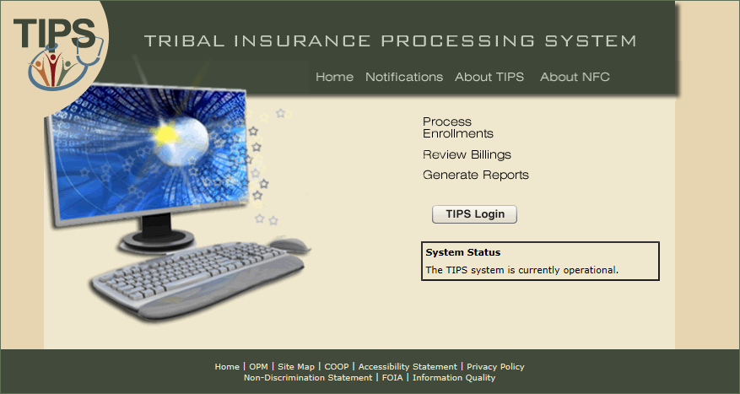
TIPS Website
Additional information can also be found on the TIPS website
Notes:
Slide Direction:
Present discussion bullets and then walk users through the NFC TIPS Website
Key Items to Consider:
None

Slide 171
Submitting Inquiries Online
TBOs and other Authorized Contacts may submit inquiries online using the ServiceNow Customer Service Portal
To add Authorized Contacts please call the TIPS Contact Center
Links to ServiceNow are available:
On the TIPS website
Inside TIPS on the Help page under the Information tab
In order to access ServiceNow you will receive a username and password from NFC
Notes:
Slide Direction:
Present discussion bullets
Key Items to Consider:
Emphasize that not everyone in TIPS is authorized to use the Remedy Requester Console
In order to get access to the Remedy Requester Console you must have a TBO or other Authorized Contact call the Contact Center to set up an account
Only TBOs are granted access immediately and will be provided their login info vis a vi email
Once an individual is identified as an Authorized Contact, NFC will email login information

Slide 172
About the ServiceNow Customer Service Portal
ServiceNow allows Tribal Employers to:
Report Issues
Request Items/Services
Check the status of incidents or requests
View Past incidents or requests
Notes:
Slide Direction:
Present discussion bullets
Key Items to Consider:
Emphasize that Remedy is an interactive tool that allow users to include a lot of helpful information on their request:
Users can make sure that NFC knows when they need the request resolved by
Users can attach files such as screen shots so NFC can understand the problem they are experiencing
Users can also track and see that their request is being worked on

Slide 173
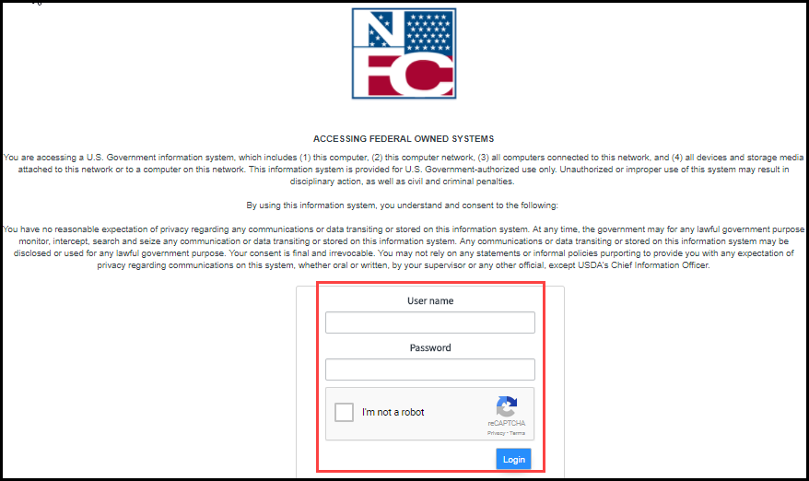
Creating a Request in ServiceNow
Log on with your User Name and Password
Notes:
Slide Direction:
Present discussion bullets and graphic
Note to learners that this point in the training go through the steps one by one of submitting a Remedy Request. Unfortunately, the training room won’t have access to the Remedy system so this part of the training will be screenshots only
Key Items to Consider:
None

Slide 174
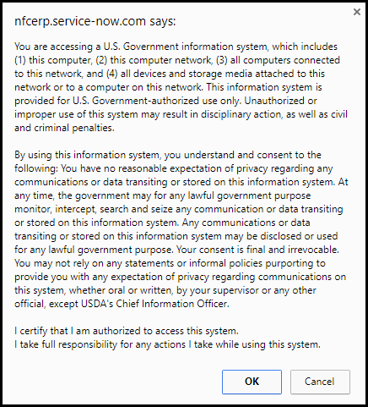
Creating a Request in ServiceNow (cont.)
Read the warning and select OK
Notes:
Slide Direction:
Present discussion bullets and graphic
Key Items to Consider:
None

Slide 175
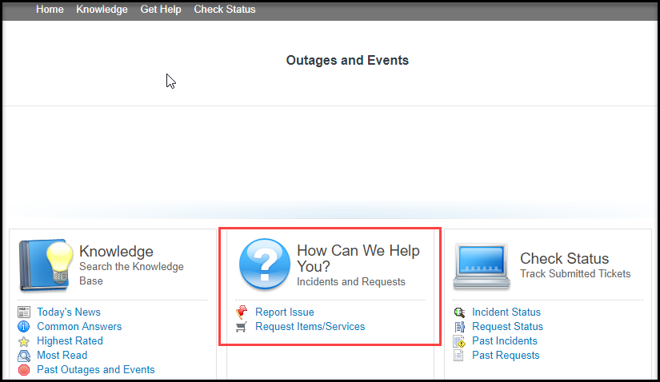
Creating a Request in ServiceNow (cont.)
Select Report Issue
Notes:
Slide Direction:
Present discussion bullets and graphic
Key Items to Consider:
None

Slide 176
Creating a Request in ServiceNow (cont.)
Fill out the required fields and select Submit
Notes:
Slide Direction:
Present discussion bullets and graphic
Key Items to Consider:
None

Slide 177
Lesson 6 Knowledge Check
Who can resolve inquiries regarding coverage plans?
FEHB Plan Carrier Call Centers
Who can resolve billing and technical inquiries?
NFC Contact Center
Who can assist with inquiries regarding navigation of the TIPS system?
NFC Contact Center
Who can resolve questions regarding policy inquiries?
OPM
Who can resolve inquiries regarding TIPS Username Setup and Security Inquiries
Your Tribal Security Officer
Notes:
Slide Direction:
Present discussion bullets
Ask additional questions on topics that learners struggle with
Key Items to Note:
None

Slide 178
Lesson 6 Summary
Now that you have completed this lesson, you should be able to:
Describe the standard Tribal Employer inquiries
Demonstrate an understanding of the types of inquiries handled by NFC and other external organizations
Demonstrate how to navigate the TIPS website
Submit an inquiry using the ServiceNow Customer Service Portal
Notes:
Slide Direction:
Present discussion bullets
Key Items to Consider:
None

Slide 179
TIPS Transactions References
Lesson 1: FEHB Overview | 30 minutes
Lesson 2: TIPS and Enrollments | 45 minutes
Break | 10 minutes
Lesson 3: Billing and TIPS Reports | 45 minutes
Morning Review | 20 minutes
Lunch | 60 minutes
Lesson 4: Special Transactions | 30 minutes
Lesson 5: Performing Transactions in TIPS | 90 minutes
Break | 10 minutes
Lesson 6: Obtaining Additional Assistance | 30 minutes
TIPS Transactions References | 10 minutes
Final Review and Evaluation | 35 minutes
Notes:
Slide Direction:
Review with learners where you are in the agenda and what’s next
Key Items to Note:
None

Slide 180
TIPS Transactions References (cont.)
Instructions on completing the TIPS activities listed below can be found in the Participant Guide:
Creating new SF 2809s in TIPS
Creating SF 2810s in TIPS
Information Only SF 2809
Managing Contacts in TIPS
Billing Functionality Guide
Electronic Upload Process
Notes:
Slide Direction:
Present discussion bullets
Update learners on current system status and any existing system limitations or inaccessible functionalities
Key Items to Consider:
Currently step-by-step instructions are not available for the activities listed below; however they will be updated in the future to include:
Managing Court Orders in TIPS
Performing a Enrollee POI Transfer
Performing a Retroactive Adjustment

Slide 181
Final Review and Evaluation
Lesson 1: FEHB Overview | 30 minutes
Lesson 2: TIPS and Enrollments | 45 minutes
Break | 10 minutes
Lesson 3: Billing and TIPS Reports | 45 minutes
Morning Review | 20 minutes
Lunch | 60 minutes
Lesson 4: Special Transactions | 30 minutes
Lesson 5: Performing Transactions in TIPS | 90 minutes
Break | 10 minutes
Lesson 6: Obtaining Additional Assistance | 30 minutes
TIPS Transactions References | 10 minutes
Final Review and Evaluation | 35 minutes
Notes:
Slide Direction:
Review with learners where you are in the agenda and what’s next
Key Items to Note:
None

Slide 182
Final Review
The class will be asked a series of 15 questions that cover all material reviewed today
Once the facilitator has finished reading each statement
Raise your hand if you know the correct answer
Notes:
Slide Direction:
Present discussion bullets
Ask additional questions on topics that learners struggle with. If no questions exist, run through the short review of 15 questions
Key Items to Note:
None

Slide 183
Final Review – Question 1
In addition to the CEO and CFO, what three contacts must Tribal employers designate when joining FEHB?
Tribal Benefits Officer, Tribal Security Officer, and Authorized Maintenance Contact
Notes:
Slide Direction:
Present discussion bullet
Ask additional questions on topics that learners struggle with
Key Items to Note:
None

Slide 184
Final Review – Question 2
What process enables you to upload multiple enrollment records or at the same time?
Electronic Upload process
Notes:
Slide Direction:
Present discussion bullet
Ask additional questions on topics that learners struggle with
Key Items to Note:
None

Slide 185
Final Review – Question 3
What are the four primary functions of TIPS?
Enrollments
Billing Reports
TIPS Reports
Special Transactions
Notes:
Slide Direction:
Three part answer that requires three clicks
Ask additional questions on topics that learners struggle with
Key Items to Note:
None

Slide 186
Final Review – Question 4
Each _______ will receive a separate Billing Report in TIPS.
Tribal Employer Billing Unit/POI
Notes:
Slide Direction:
Present discussion bullet
Ask additional questions on topics that learners struggle with
Key Items to Note:
None

Slide 187
Final Review – Question 5
The Final Billing Report closes at this time each month.
11:59 PM MST on the last calendar day of the month
Notes:
Slide Direction:
Present discussion bullet
Ask additional questions on topics that learners struggle with
Key Items to Note:
None

Slide 188
Final Review – Question 6
_____ will contact Tribal Employers if they are billed and insufficient funds are available in their account.
OPM
Notes:
Slide Direction:
Present discussion bullet
Ask additional questions on topics that learners struggle with
Key Items to Note:
None

Slide 189
Final Review – Question 7
TIPS Reports can be viewed in either _______ or _______.
The TIPS Web Portal (Online) or in Microsoft Excel
Notes:
Slide Direction:
Present discussion bullet
Ask additional questions on topics that learners struggle with
Key Items to Note:
None

Slide 190
Final Review – Question 8
Who is responsible for initiating and managing the creation of a Tribal Employer’s TIPS user accounts?
Tribal Security Officer (TSO)
Notes:
Slide Direction:
Present discussion bullet
Ask additional questions on topics that learners struggle with
Key Items to Note:
None

Slide 191
Final Review – Question 9
In TIPS, which tab would you select in order to Create an initial 2809?
Forms
Notes:
Slide Direction:
Present discussion bullet
Ask additional questions on topics that learners struggle with
Key Items to Note:
None

Slide 192
Final Review – Question 10
In TIPS, which tab would you select in order to Create a 2810?
Inquiry
Notes:
Slide Direction:
Present discussion bullet
Ask additional questions on topics that learners struggle with
Key Items to Note:
None

Slide 193
Final Review – Question 11
What is the status of a SF 2809 that has been completed and sent to the FEHB Plan Carriers, but not processed for billing?
Submitted and Released
Notes:
Slide Direction:
Present discussion bullet
Ask additional questions on topics that learners struggle with
Key Items to Note:
None

Slide 194
Final Review – Question 12
What button would a TIPS user select to edit an incorrect SF 2809 that has already been Submitted and Released but not Processed?
The “Hold” button
Notes:
Slide Direction:
Present discussion bullet
Ask additional questions on topics that learners struggle with
Key Items to Note:
None

Slide 195
Final Review – Question 13
What fields can you search by when performing an Inquiry in TIPS?
Name (first, middle, and last) and Social Security Number
Notes:
Slide Direction:
Present discussion bullet
Ask additional questions on topics that learners struggle with
Key Items to Note:
None

Slide 196
Final Review – Question 14
What TIPS Report allows you to see source data from all Tribal Employee forms?
Overall 2809/2810 Report
Notes:
Slide Direction:
Present discussion bullet
Ask additional questions on topics that learners struggle with
Key Items to Note:
None

Slide 197
Final Review – Question 15
What information must you have in order to transfer an enrollee to a POI managed by your Tribal Employer
First Name, Last Name, Social Security Number
Notes:
Slide Direction:
Present discussion bullet
Ask additional questions on topics that learners struggle with
Key Items to Note:
None

Slide 198
Course Summary
Now that you have completed this course, you should be able to:
Describe the FEHB key stakeholders relative to TIPS
Identify how TIPS supports Tribal Employers
Explain the employee enrollment process
Explain the billing and payment processes
Enroll employees in TIPS using individual forms and Electronic Uploads
Run and review TIPS Reports and Billing Reports in TIPS
Describe special transactions including: Billing Unit/POI Transfers, Retroactive Adjustments, and Court Orders
Demonstrate how to navigate the TIPS website
Submit an inquiry using ServiceNow
Notes:
Slide Direction:
Present discussion bullets
Ask additional questions on topics that learners struggle with
Key Items to Note:
None

Slide 199
Evaluation
Notes:
Slide Direction:
Present discussion bullets
Ask additional questions on topics that learners struggle with
Key Items to Note:
At this time as participants to take out a pen or pencil and put away their participant guides and any notes. This will be a closed book evaluation (L1 only). The evaluation will ask participants to answer questions about their experience with different aspects of the course (Level 1)
Participants will also be provided with a self-assessment. This question assessment is for participants specifically to evaluate their own performance. The answers are included on the third page of the self-assessment

Slide 200
Thank you!

