Slide 1
The Future of Federal Financial Management
Fiscal Service | U.S. Department of the Treasury | June 2019

Slide 2
Americans Financial Interactions with the Federal Government
Every day, millions of Americans have financial interactions with the federal government.
The American citizen expects that:
1. the government is an efficient steward of its financial resources;
2. the financial information provided by the government is accurate;
3. their financial interactions with the government are modern, seamless and secure.”

Slide 3
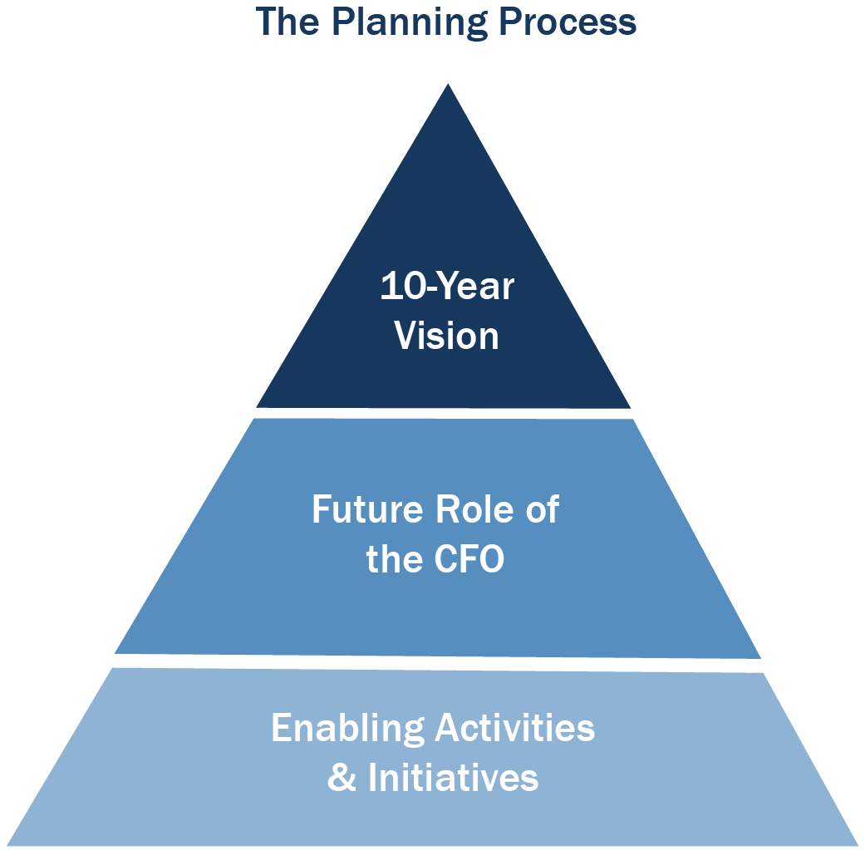
Engaging the Federal Financial Management Community
The Destination
Leadership
How We’ll Get There

Slide 4
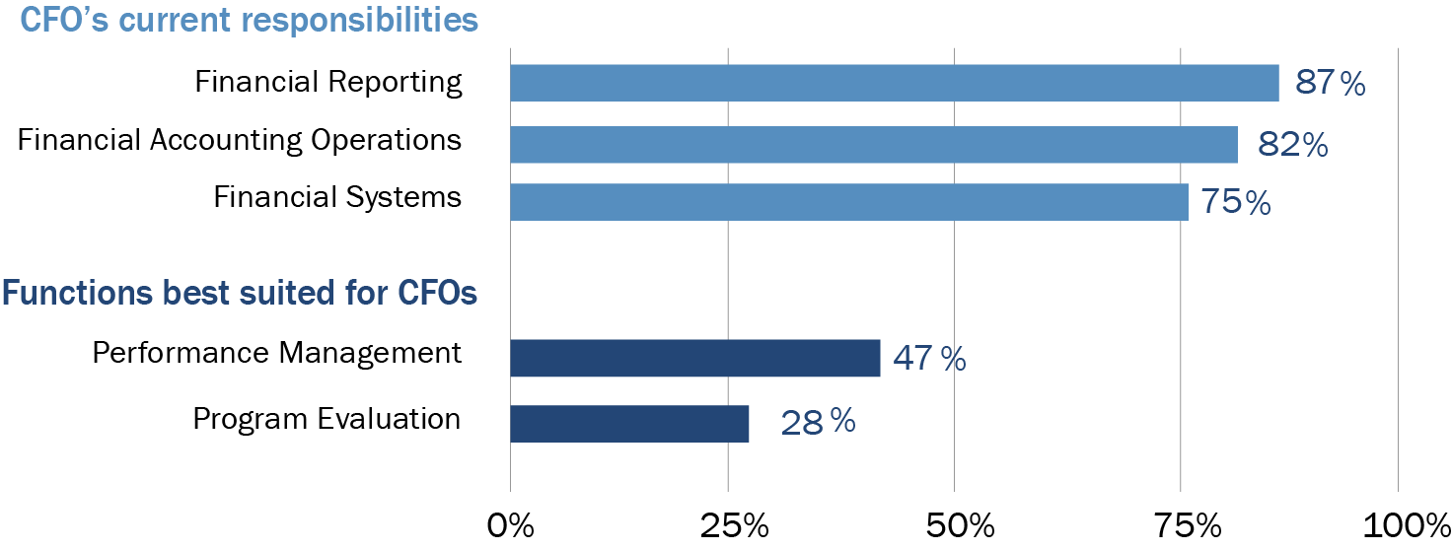
CFO View: Refocus from Financial Transaction Processing to Performance Measurement and Analysis
CFO Survey: Current Responsibilities vs. New Roles
SOURCE: “Annual CFO Survey: Navigating Disruption”, Association of Government Accountants, January 2018.
Less CFO Time To Be Spent On: | More CFO Time To Be Spent On:
Financial transactions Financial systems/IT Compliance Low-value reporting | Thought leadership Data analytics Performance monitoring and management

Slide 5
A New Role for Agency CFOs
CFOs are harnessing program and cost data to support agencies in achieving their missions.
5
Strategic Planning & Mission Support
4
Communicating
Results
Develop strategic plan linked to program performance
Operational support and decision-making
Performance evaluation
Use of advanced data analytics and use of data as a strategic asset
Data Management & Analytics
3
Financial and management reporting
Program performance reporting
External communications
2
Financial & Regulatory Controls
Performance measurement
IT management
High-quality data creation
1
Core Budget & Accounting Operations
Regulatory compliance
Accounting policy
Risk management
Internal controls
Budget formulation and execution
Transaction processing

Slide 6
How Will We Get There?
Transform Federal Collections
Retire the lockboxes
Transform accounts receivable processing
Strengthen Financial Reporting
Automate interagency buy-sell transactions
Implement single financial statement
Make federal financial data more accessible
Strengthen Financial Reporting
Automate interagency buy-sell transactions
Implement single financial statement
Make federal financial data more accessible

Slide 7
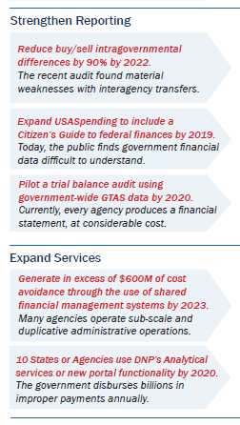
CFO Letter for FY 2019

Slide 8
Annual Report on Progress

Slide 9
To Learn More
https://fmvision.fiscal.treasury.gov/

