Slide 1
GTAS Updates
presented by the
Financial Reporting Branch

Slide 2
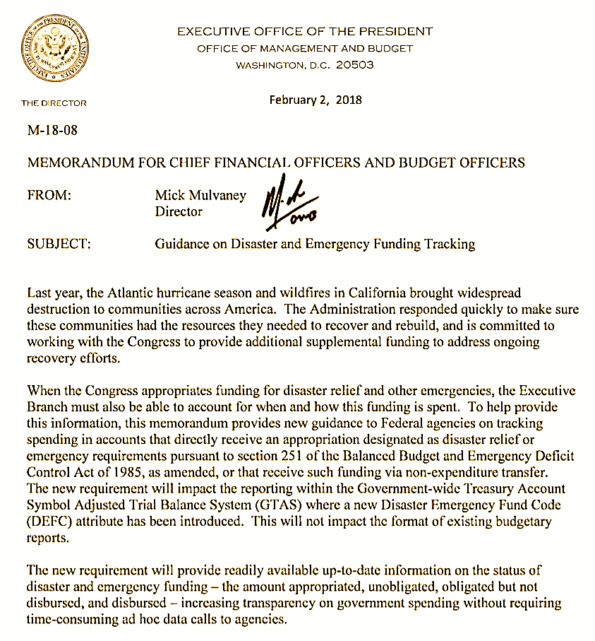
Disaster & Emergency Funding
OMB M-18-08:
Guidance on Disaster and Emergency Funding Tracking
Established the Disaster Emergency Fund Code (DEFC) to streamline funds accountability of appropriations designated for disaster relief or as emergency requirements

Slide 3
Disaster & Emergency Funding(a)
Who is Required to Follow Guidance?
Agencies with appropriations designated as an emergency requirement in the Supplemental Appropriations for Disaster Relief Requirements Act, 2017 (P.L. 115-56)
No USDA agencies cited
https://www.gpo.gov/fdsys/pkg/PLAW-115publ56/pdf/PLAW-115publ56.pdf
Agencies with appropriations designated as an emergency requirement in the Additional Supplemental Appropriations for Disaster Relief Requirements Act of 2017 (P.L. 115-72).
Includes Forest Service
https://www.gpo.gov/fdsys/pkg/PLAW-115publ72/pdf/PLAW-115publ72.pdf

Slide 4
Disaster Emergency Fund Code (DEFC)
OMB, as the authoritative source, will assign a new DEFC domain value code based on the Public Law number and disaster or emergency designation
Treasury will update the USSGL Treasury Financial Manual Supplement
USDA will manage funds using the DEFC in FSDW based upon agency tracking methods in place, i.e. unique fund for each funding event

Slide 5
Disaster Emergency Fund Code (DEFC)a
Each DEFC (domain values A – Z, except Q) will identify funding as disaster or emergency and include the Public Law number
For GTAS reporting purposes, the default for all funding not classified as disaster or emergency is Q
DEFC will take the place of Program Indicator on the GTAS bulk file
Implementation of the code will impact GTAS reporting
Implementation will not impact apportionments, SF-133 reports, or Schedule P

Slide 6
Disaster Emergency Fund Code (DEFC)b
Impacted USDA Agencies
Agencies with future appropriations designated as disaster relief or as emergency requirements, including those listed in the Further Additional Supplemental Appropriations for Disaster Recovery Requirements Act, 2018
Includes Office of the Secretary, Office of the Inspector General, Agricultural Research Service, Forest Service, Natural Resources Conservation Service, Rural Development, and Food and Nutrition Service
https://www.congress.gov/bill/115th-congress/house-bill/1892/text?q=%7B%22search%22%3A%5B%22bipartisan+budget+act+2018%22%5D%7D&r=1

Slide 7
Disaster Emergency Fund Code (DEFC)c
USDA Implementation
Each new disaster/emergency event will necessitate a new unique value to be established in FMMI as a proper tracking mechanism.
The most effective way to monitor DEFC spending is to establish unique values in FMMI, such as a new fund, that will only be used for Disaster/Emergency Funding.
Each unique value established in FMMI will have inference rules applied in FSDW to populate the appropriate DEFC on GTAS reports. As agencies receive disaster/emergency funding, they must request the new Front End Inference Rule based upon their unique situation.
USDA will replace the Program Indicator field in FSDW with DEFC to capture the disaster and emergency fund data for GTAS reporting.
The DEFC field will automatically default to Q (non-disaster or emergency) for GLs requiring DEFC unless FSDW inference rules are in place to recognize the unique disaster/emergency tracking values feeding over from FMMI.

Slide 8
Disaster Emergency Fund Code (DEFC)d

Slide 9
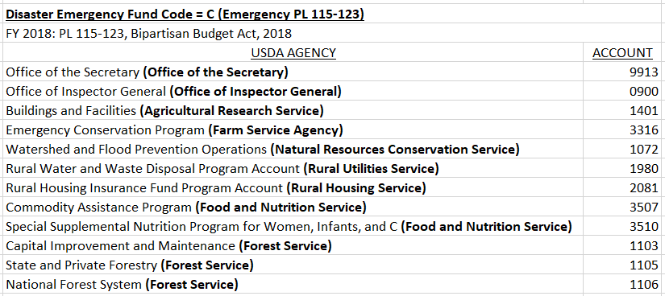
Disaster Emergency Fund Code (DEFC)e

Slide 10
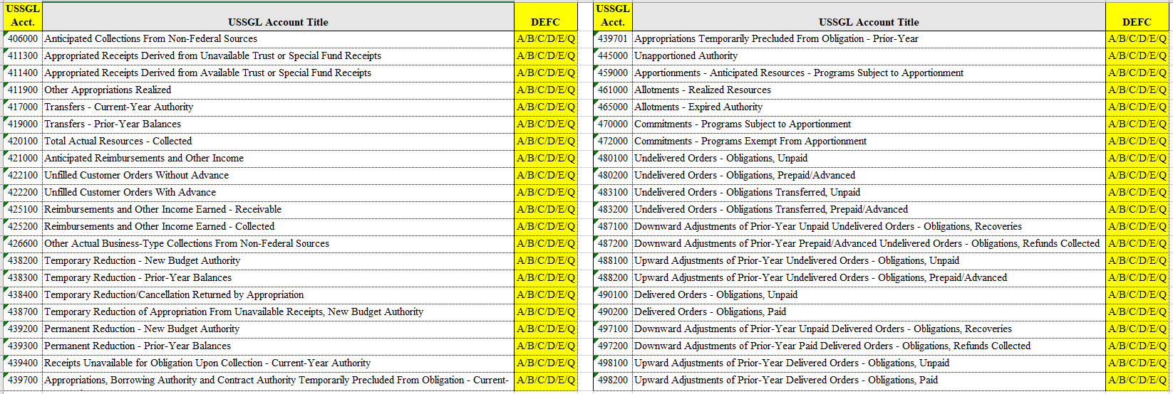
Disaster Emergency Fund Code (DEFC)f
Affected GLs most commonly used by USDA

Slide 11
New GTAS Edits
For FY 18, Treasury implemented several new GTAS edits effective with Period 08 reporting.
Edits and other GTAS reporting updates may be located at:
https://tfm.fiscal.treasury.gov/v1/supplements/ussgl.html

Slide 12
New GTAS Editsa
The most notable new edits for USDA agencies are edits to ensure that certain lines of the SF-133 reflect either a zero or normal balance.
Specifically, edits 79, 84, 92, and 94 will have the largest impact on USDA.

Slide 13
New GTAS Editsb
Edits 79 and 84
Edit 79 – SF-133 Line 1750 Balance Check (must be ≥ 0)
Spending authority from offsetting collections, discretionary (total)
Edit 84 – SF-133 Line 1850 Balance Check (must be ≥ 0)
Spending authority from offsetting collections, mandatory (total)

Slide 14
New GTAS Editsc
Normal Flow
Sales Order Created → need to create an unfilled order
Debit GL 422100 - Unfilled Customer Orders Without Advance
Work Performed → need to decrease unfilled order and increase receivable
Debit GL 425100 - Reimbursements and Other Income Earned – Receivable
Credit GL 422100 - Unfilled Customer Orders Without Advance
Collection Received → need to decrease receivable and increase collection
Debit GL 425200 - Reimbursements and Other Income Earned – Collected
Credit GL 425100 - Reimbursements and Other Income Earned – Receivable

Slide 15
New GTAS Editsd
Edits 79 and 84
Abnormal lines 1750 and 1850 most typically occur when unfilled customer orders are written down, GL 422100, without a corresponding receivable/collection.
The decrease in GL 422100 without corresponding increases in receivable/collection GLs generates abnormal activity on either line 1701 or 1801, which is then captured on line 1750 or 1850 creating an overall abnormal spending authority balance.

Slide 16
New GTAS Editse
Edits 92 & 94
Edit 92 – SF-133 Line 4011 Balance Check (must be ≥ 0)
Outlays from discretionary balances
Edit 94 – SF-133 Line 4101 Balance Check (must be ≥ 0)
Outlays from mandatory balances

Slide 17
New GTAS Editsf
Edits 92 & 94
Abnormal lines 4011 and 4101 occur when total outlays are abnormal.
Activity in GL 480200 is combined with the ending balance in GLs 488200, 490200 and 498200 to calculate the totals on these lines.
Corrective Action: Spending Adjustment
Function | TM | TM_TV | FMMI Role | Document _Type | Description | Fund Type | Prop Acct Debit (+) | Prop Acct Credit (-)
B2 - Balancing Document | B2 | B2_SP | G/L Processor | SU - GL Adjustment | Downward Adj-Prior Yr Unpaid Undel Ord-Oblig Recov | All fund types | 487100UPDN | 480100UPDN
B2 - Balancing Document | B2 | B2_ST | G/L Processor | SU - GL Adjustment | Downward Adj-Prior Yr Unpaid Deliv Ord-Oblig Recov | All fund types | 497100UPDN | 490100UPDN
B2 - Balancing Document | B2 | B2_SX | G/L Processor | SU - GL Adjustment | Downward Adj-Prior Yr Prepaid Undl Ord-Refunds Col | All fund types | 487200UPDN | 480200UPDN
B2 - Balancing Document | B2 | B2_SY | G/L Processor | SU - GL Adjustment | Down Adj of Pr-Yr Pd Deliv Order-ObRfnds Dir Post | All fund types | 497200UPDN | 490200UPDN
B2 - Balancing Document | B2 | B2_UP | G/L Processor | SU - GL Adjustment | Upward Adj-Prior Yr Undeliv Order- Oblig, Unpaid | All fund types | 480100UPDN | 488100UPDN
B2 - Balancing Document | B2 | B2_SR | G/L Processor | SU - GL Adjustment | Up Adj of Prior-Year Deliv Orders - Ob, Unpaid | All fund types | 498100UPDN | 490100UPDN

Slide 18
Trading Partner Main Account
Phase-in Approach
FY 2015:
The Trading Partner Main Account Code is required for TAS with a 2015 beginning period of availability.
• FY 2016 - 2018:
Each year, the Trading Partner Main Account will be required for the current FY period of availability.
• FY 2019:
The Trading Partner Main Account will be required for all TAS including X year beginning October 1, 2018.

Slide 19
Trading Partner Main Accounta
During the initial implementation of the Trading Partner Main Account, FMS created edits within FMMI based upon beginning budget period.
Federal transactions with beginning period of availability of 2015 or later required an entry to the GTAS US Government Fields in FMMI so that appropriate Trading Partner details could be provided via GTAS.
Currently, discussions are taking place regarding the expansion of that edit to include all transactions.
Additionally, agencies must review their ledger transactions for balances without Trading Partner Main Account details and process correcting entries in FMMI for documents creating these balances.
Treasury’s phase-in includes agencies outside of the FMMI system as well, thus research is required by those agencies to ensure compliance.

Slide 20
Trading Partner Main Accountb
Resources
GTAS Edits and Validations information can be found at:
https://tfm.fiscal.treasury.gov/v1/supplements/ussgl/ussgl_part_2.html
Three-digit Agency Identifier Codes and Main Accounts are defined in the Federal Account Symbols and Titles (FAST) Book II and can be found at:
https://www.fiscal.treasury.gov/fsreports/ref/fastBook/fastbook_home.htm

