Slide 1
Financial Management Services
DATA ACT – D2 Process
Overview

Slide 2
DATA ACT
DATA Act - Digital Accountability and Transparency Act of 2014 is a law that aims to make information on federal expenditures more easily accessible and transparent.

Slide 3
Data Act Reporting Segments
DATA Act directs the federal government to standardize and publish a wide variety of reports and data compilations related to obligations and spending: financial management, payments, budget actions, procurement, and assistance.
File A – Appropriations
File B- Program Activity Object Class
File C- Awards Financials
File D2 – Award Attributes

Slide 4
DATA ACT
DATA Act – D2 Process Overview

Slide 5
D2 Process Schedule Key Dates
First semi-monthly processing
1st of the month – CRM Extract is run
3rd of the month – D2 Internal Process runs at 6:30 am
4th and 5th of the month – D2 Internal Process is run on demand after the business day to process files that have come in since the initial processing
5th of the month – Files are submitted to the FABS portal
Second semi-monthly processing
16th of the month - CRM Extract is run
18th of the month – D2 Internal Process runs at 6:30 am
19th and 20th of the month – D2 Internal Process is run on demand after the business day to process files that have come in since the initial processing
20th of the month – Files are submitted to the FABS portal

Slide 6
D2 Inbound Data

Slide 7
STEP 3: Processing Agency Files in PB7 Continued…..
Pre-Validation program ZDATA_ACT_FILE_VALIDATION, processes the files from DATA_ACT/inbound
Folder.
Pre-Validation program processes multiple files
After processing multiple files,
If the files pass the pre-validation, files will be left in the DATA_ACT/inbound for further processing
If the files fail the pre-validation, bad files will be moved to DATA_ACT/bad_D2 folder along with error log
Program sends email to the respective agency POC and to the team along with error log, agency needs to fix the issue identified in the error log and resend the failed file again for re processing
Further follow-up from the team may be required to re process the failed files
If the Agency Code is not part of the inbound file, process chain fails. Inbound file must have agency code part of the file name

Slide 8
Agency Files On BW Server
INBOUND FILES
Agencies send the file to the Drop Box, from the drop box files are transferred to BW Server by PI Team. If the files are missing on the BW Server, contact PI team
On the BW Server the files to be processed are stored in
/sapmnt/PB7/EAIData/INT/DATA_ACT/inbound
After a file is processed the file in the original format is stored in
/sapmnt/PB7/EAIData/INT/DATA_ACT/archive
Each agency file is processed through a validation program (ZDATA_ACT_FILE_VALIDATION) and if a file is bad, it is moved to /sapmnt/PB7/EAIData/INT/DATA_ACT/bad_D2 directory
OUTBOUND FILES
The file to be sent are stored in :
/sapmnt/PB7/EAIData/INT/DATA_ACT/TRES/ outbound/holding directory
Once the file is submitted to FABS the file should be moved
From : /sapmnt/PB7/EAIData/INT/DATA_ACT/TRES/outbound/holding
To : /sapmnt/PB7/EAIData/INT/DATA_ACT/TRES/outbound/submitted

Slide 9
On-going Production Supoort of D2
Execute D2 On Demand Process Chain Per Agency Request
Submit Request CRM Extract to PI Team
Trouble Shoot D2 Inbound Issues and Assist Agency With Problem Identification and Resolution
Review and Constantly Monitor D2 Processing as Inbound Files are Processed and Archived in the USDA DATA_ACT Repository
Report D2 File Inbound Format Issues to Agencies and Assist with Resolution as Needed
Report D2 Errors and D2 Certification Outcomes to Agencies
Publish Files to the US Treasury Site Following Inhouse Processing
Attend ERB, CCB, and TCCB Meeting to Field Questions From Change Management Team
Create Appropriate Service Tickets as Needed to Track D2 Issues

Slide 10
Check List for D2 Processing
D2 Process
D2 Certification Process
Run the CRM extract program
*Once after 2nd and 17th
Agency Approved ?
NO
Follow up with Agency
Files exist on BW Server
NO
Follow up with PI Team – Check on drop box
YES
YES
MOVE Agency file on BW Server
From: DATA_ACT/TRES/outbound/holding
To: DATA_ACT/TRES/outbound/submitted
Run the main process chain
ZDA_D2_MAIN
Success / Failure
FAILURE
STOP
(Investigate the cause for failure)
Submit File to FABS Portal
SUCCESS
Error Records exist ?
Publish the good records to the FABS Portal
YES
Send Error Report to Agency
Run D2 Error Publication
NO
Good Records exist
END
YES
Send Certification Report to Agency
Run D2 Cert Publication

Slide 11
Processing Agency Files in PB7
There are 5 steps in processing
STEP 1: Run the DATA ACT Extract program in CRM
STEP 2: Run the D2 Main Chain (Scheduled OR On-Demand)
STEP 3: Run the FABS Out (Generates FABS files)
STEP 4: Run the Publication of Error Report
STEP 5: Run the Publication of Certification Report
Note: STEPS are conditional – Refer to flowchart

Slide 12
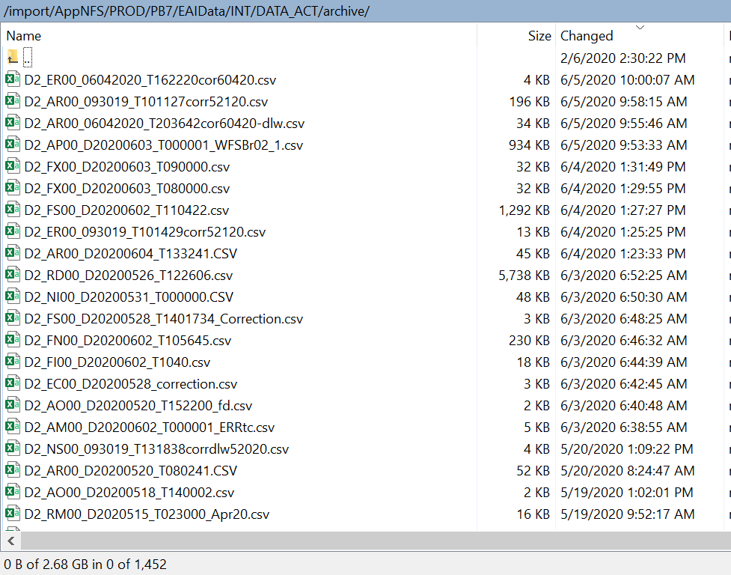
DATA ACT Archive

Slide 13
STEP 4: Publication of Error Report
1) Run the Data Act File Process Log Report the latest date to see all activities.
2) Run the D2 Daily Error Report to find the list of agencies to send the Error Reports
STEP 4: This step will send the error report to Agency POC
Each file processed should produce error or certification report, or it can produce error and certification report. Run the D2 DAILY ERROR REPORT to find which agency should receive the error report.
Navigate to the publication in FMMI/HANA/DATA ACT/ DATA ACT D2 ERROR REPORT PUBLICATION
Right-click the publication and select Schedule
Click Prompts:
Click Modify, select the Business Area that was just processed in the prompts window (for instance, if you just processed FS00, select FS00) , moving it to the right pane, and click Apply
Click Dynamic Recipients:
De-select the AM00 business area, moving it out of the Selected pane
Select the Agency you are scheduling for and move it to the Selected pane
NOTE: DYNAMIC RECIPIENTS MUST BE SELECTED LAST, JUST BEFORE SCHEDULING THE PUBLICATION
Click Schedule

Slide 14
STEP 5: Publication of Certification Report
STEP 5: This step is will send the certification report to the agency
Navigate to the publication in FMMI/HANA/DATA ACT/ DATA ACT D2 CERTIFICATION REPORT PUBLICATION
Execute this process for the most recent submission date, for each Business Area processed on that date
Right-click the publication and select Schedule
Click Prompts:
Click the first Modify, select the Submission Date/Business Area in the prompts window, moving it to the right pane, and click Apply
Click the second Modify, select the Business Area in the prompts window, moving it to the right pane, and click Apply
If the prompt did not get applied (Business Area selection does not appear by the Modify button), click Formats (Do not change settings) and then go back to Prompts to set the second prompt
Click Dynamic Recipients:
De-select the AM00 business area, moving it out of the Selected pane
Select the Agency you are scheduling for and move it to the Selected pane
NOTE: DYNAMIC RECIPIENTS MUST BE SELECTED LAST, JUST BEFORE SCHEDULING THE PUBLICATION
Click Schedule

Slide 15
FABS – Submission Spreadsheet Status

Slide 16
Questions ?

